Slide 1



Social and Emotional Learning: Feedback and Communications Insights from the Field
Findings from market research conducted for The Wallace Foundation
By Edge Research
Full report
December 2016
https://doi.org/10.59656/YD-G8958.001

Slide 2
Goals for Research
Primary
Understand the landscape of terminology from the perspective of key stakeholders
Understand what motivates
K-12 public school, Afterschool and Policy leaders to be interested in the topic
Help the field develop a common vocabulary on the topic
Secondary
Understand where social and emotional learning fits in context with other competing priorities
  Understand how key audiences think about social and emotional learning connecting to their work
  Produce findings that support the communications efforts of Wallace, partners and the community

Slide 3
Market Research Approach
Phase I: Desktop Research (Summer 2015)
Edge synthesized background materials provided by Wallace, web searches, text analytics and trends data. This led to an inventory of terms and initial hypotheses. Findings informed a working session with Wallace and a short list of terms for further study.
Phase II: Qualitative Research Among Professionals (Fall 2015)
Edge completed 45 in-depth interviews among K-12, Afterschool and Policy leaders. Discussions explored perceptions of terms and the topic in more detail. Findings informed a messaging session with Wallace, where the team started to draft content for the survey phase.
Phase III: Quantitative Research Among Professionals (Winter 2016)
Online survey of n=1,600 Professionals (192 Policymakers; 331 K-12 Leaders; 620 Afterschool Leaders). Wallace designated 5 terms of interest, and Edge designed a survey to test the strengths and weaknesses of those terms. The survey also explored potential message frames.
Follow Up: Focus Groups with Parents (Spring 2016)
As follow up to marketing research among professional audiences, Wallace asked Edge to gather parent feedback. Conversations with low income parents helped the team understand SEL mindset, gut-check terminology, and continue the learning on framing and messaging.

Slide 4
Table of Contents
Executive Summary pages 5-26
Findings from Desktop Research pages 27-49
Findings from Qualitative Interviews pages 50-71
Findings from Quantitative Surveys pages 72-112
Findings from Parent Focus Groups pages 113-132

Slide 5
Key Findings
1
There is no “silver bullet” term, but across the research phases, “social and emotional learning” emerges as one that is familiar and clear for Policy, K-12 and Afterschool leaders. It also tests well in parent focus groups.
2
Over the course of research, we moved away from terms that had strong, ancillary or even negative connotations (21st Century Skills, Whole Child Development, Soft Skills, Character). We also eliminated familiar terms deemed too generic for this topic (Youth Development, Success Factors).
3
In framing this issue, a concept that speaks to “Gains” for children has traction. Specifics about SEL skills (i.e. building positive relationships, navigating social environments), plus positively asserting that all children benefit, make this frame popular across stakeholder and parent audiences.
4
Other frames include language that resonates. Consider the right time to weave in themes and ideas about: all adults having a role, the learning equation, children realizing their potential, future citizens and the opportunity gap.
5
Despite agreement that SEL should be a priority, challenges exist for the future. The field identifies training and professional development as much-needed. Parents are wary of school and afterschool overstepping their bounds.

Slide 6
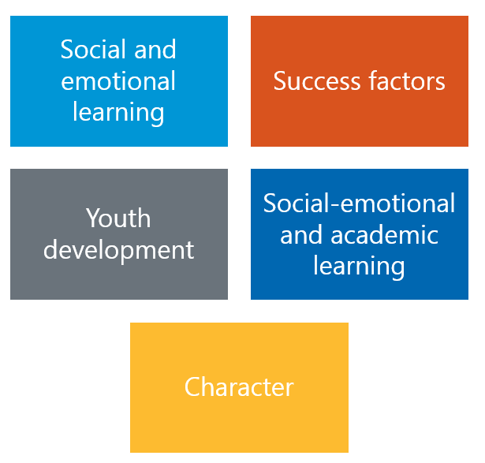
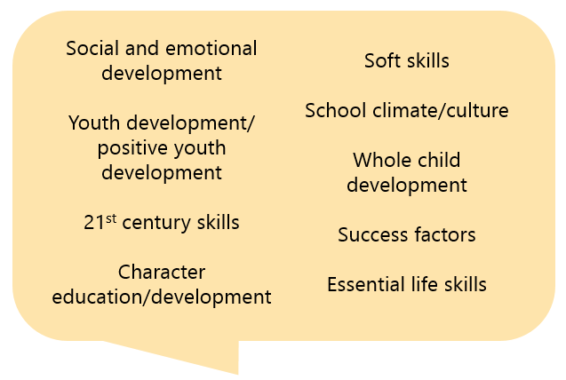
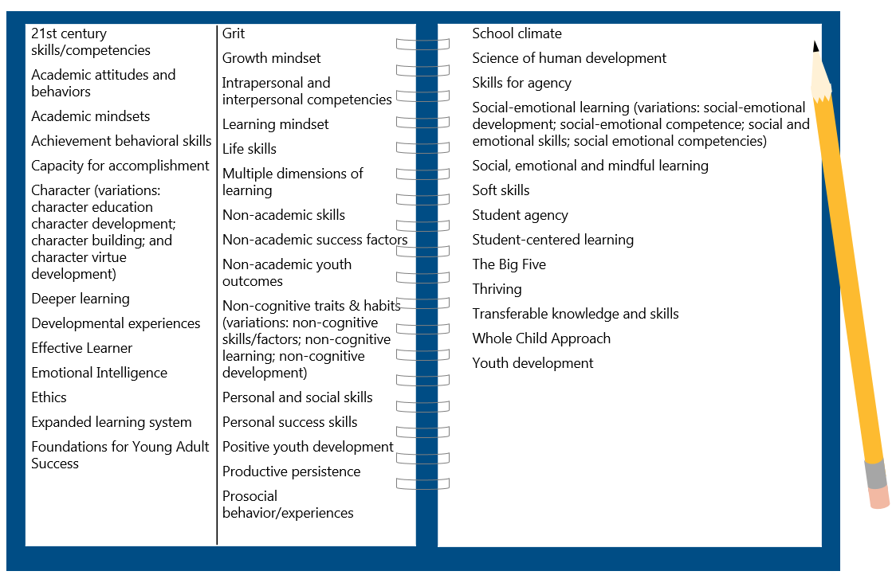
Learning Path
2 Finalist Terms: SEL and SEAL
Parent focus groups revisited the landscape of terms and vetted these two terms
5 Terms of Interest in Quantitative
9 Terms Explored in Interviews
All with merit; all received the same treatment in the survey
Identified by working session; led to terms for survey testing
40+ Terms Circulating
Assessed in desktop research

Slide 7
Desktop Research: 40+ Terms Circulating
Desktop research identified 40+ terms for this topic, with countless variations.
21st century skills/competencies Academic attitudes and behaviors Academic mindsets Achievement behavioral skills Capacity for accomplishment Character (variations: character education character development; character building; and character virtue development) Deeper learning Developmental experiences Effective Learner Emotional Intelligence Ethics Expanded learning system Foundations for Young Adult Success | Grit Growth mindset Intrapersonal and interpersonal competencies Learning mindset Life skills Multiple dimensions of learning Non-academic skills Non-academic success factors Non-academic youth outcomes Non-cognitive traits & habits (variations: non-cognitive skills/factors; non-cognitive learning; non-cognitive development) Personal and social skills Personal success skills Positive youth development Productive persistence Prosocial behavior/experiences
School climate Science of human development Skills for agency Social-emotional learning (variations: social-emotional development; social-emotional competence; social and emotional skills; social emotional competencies) Social, emotional and mindful learning Soft skills Student agency Student-centered learning The Big Five Thriving Transferable knowledge and skills Whole Child Approach Youth development

Slide 8
Desktop Research: Term Inventory
Analyzing terms on four dimensions helped Wallace prioritize terms of interest.
C
 | Frequency (how often used) | Clarity (of meaning) | Acceptance (by stakeholders) | Sources (who is using it)
21st Century Skills | High | Mixed | High | Many
Soft Skills | High | Mixed | High | Many
Social and Emotional | High | Mixed | To be determined | Many
Grit | Medium | Mixed | Medium | Some
Growth Mindset | Medium | Mixed | Medium | Few
Whole Child Development | Medium | Mixed | Medium | Few
Character Development | Medium | Negative | Low | Few
Non-Cognitive | Mixed | Negative | Low | Limited
Positive Youth Development | Low | Positive | Medium | Few
Academic Attitudes | Low | Negative | Medium | Few
Behavioral Skills | Low | Negative | Low | Few
Key: Higher, Middle, Lower

Slide 9
Qualitative: Findings on Terms
Over the course of 45 stakeholder interviews, we learned that these terms had more potential to be effective than others. At the same time, all had pitfalls.
Social and Emotional Learning
Conveys the right subject matter and is used often in K-12 and Afterschool.
Some feel the phrase lacks urgency.
Whole Child Development
Provides an opening to talk about SEL, but much broader. Of the four finalist terms, this is probably the most ideological and divisive.
Success Factors
Sets the right tone for shared goals, qualities to nurture in a student.
However, it’s generic and not an obvious bridge to talking about SEL.
Youth Development
The epitome of a “widely accepted” term and often preferred. But it might be hard to energize target audiences around an idea so familiar and broad.

Slide 10
Social and Emotional Learning
✓
DESCRIPTIVE
ACCEPTANCE
URGENCY
Covers a wide range of skills including self-management, conflict resolution, teamwork
Broadest interpretations include mental health supports and services
Some sources point out the important difference between social learning and emotional learning
Some difference in interpretations of social and emotional “learning” and “development”
Leading term in use today; default term for many
Acceptable to all three stakeholder audiences
At the same time, sources say the phrase is too much like jargon
Politically neutral, but talking about “emotions” gives some a liberal feel
“Learning” can be uniting (active, intentional)
Buzzword “of the moment” for Afterschool and some K-12 leaders
An open question is whether it will resonate with a wider audience
(e.g. policy, parents)
Can feel “too touchy feely” to be a priority for policy
Overall, lacks urgency
BOTTOM LINE
Conveys the right subject matter and is used often in K-12 and Afterschool.
But the phrase can be seen as “jargon” and lacks some urgency.

Slide 11
Whole Child Development
✓
DESCRIPTIVE
ACCEPTANCE
URGENCY
Accounts for all aspects of a child’s growth: academic, physical, social and emotional
“Holistic” approach to learning
May or may not include basic needs: food, shelter
Sources say this concept is much bigger than SEL (social and emotional learning would be a component under it)
The conventional meaning helps tie SEL to academics
“Child” implies young students (K-8)
Many in interviews say it is a “progressive” concept, linked to “liberal” ideology
Some respondents raise a red-flag saying critics will argue this is beyond the role of schools
More than one source criticizes this term as jargon
“Old” term but robust
Many favorable toward it
Preconceived notions (people attach their own meanings – positive and negative)
Overuse is a concern (a reason to tune out)
Expansiveness is a concern (taking us away from the practice of SEL)
BOTTOM LINE
Provides an opening to talk about SEL, but much broader. Of the four finalist terms, this is probably the most ideological and divisive.

Slide 12
Success Factors
✓
DESCRIPTIVE
ACCEPTANCE
URGENCY
Puts the focus on outcomes and benefits (more than approach or practice)
Implies long-term: college and career readiness more so than other terms
Competing definitions of “success” make it vague
Calls attention to “deficits” often environmental:
What does success mean? Can students defy the trend and expectations?
Success means different things to different people; K-12 see it as test scores, Afterschool tend to see it more in the realm of SEL
A new term – has currency, but is still being defined
Heard more in K-12 than Afterschool or Policymaker interviews
Sources are enthusiastic about this term - everyone cares about success
“Starting to catch on” since Department of Ed started using this language
Gets leaders thinking about what makes people successful
While they perk up at the language, it is also generic, and it takes a transition message to get to SEL
BOTTOM LINE
Sets the right tone for shared goals, qualities to nurture in a student.
However, it’s generic and not an obvious bridge to talking about SEL.

Slide 13
Youth Development
✓
DESCRIPTIVE
ACCEPTANCE
URGENCY
Is a crowd-pleasing term with a wide variety of definitions
According to sources, it includes SEL, providing opportunities to students
“More than reading and math” is a common way to explain it
Most closely affiliated with Afterschool; but K-12 and Policymakers embrace the term in these interviews
A pitfall is that it seems to imply older “youth”
(tweens and teens)
Politically neutral and versatile: can evoke responsibility (appealing to conservatives) or independent thinking (appealing to liberals)
Familiar language, but no real urgency, it might be difficult to rally support
Risk in being too familiar, something these audiences already know and do
That some communities are adopting this term now might suggest new interest
It is consistently appealing, often preferred in these interviews
BOTTOM LINE
The epitome of a “widely accepted” term and often preferred. But it might be hard to energize target audiences around an idea so familiar and broad.

Slide 14
Qualitative: Less Effective Terms
✓
Term | Descriptive | Acceptance | Urgency | Bottom line
21st century skills | Used loosely and with multiple meanings. | Heard or used by all audiences and business leaders. Rejected by many who see it as dated and/or gimmicky. | Relevant to today’s world. What kids need now (or needed 10 years ago). | A lot of unrelated connotations (tech, workforce, funding). At worst “old hat.”
Character | Morals, ethics, positive social interaction, compliance, respect, responsibility, civic duty. | Everyone understands it. More appealing to conservatives. | Unclear if this is education’s job—overstepping family role? Dated for some. | Ideological red flags: “moral” implications, “religion,” “elitism.”
Soft skills | Emotional intelligence, communication and relationships - things that can’t be graded. | Used by some educators, afterschool and business community. | “Soft” diminishes importance and urgency. | Too many strikes against this term. Many sources say they won’t use it.
School climate/ culture | Conditions in which school and SEL happen, safety, discipline. | Alienates afterschool. | A related and important concept - necessary for SEL to occur and a result of SEL. | Too broad to be the lead term. Exclusive to schools.
Essential life skills | Basic skills for daily living (i.e. budgeting), prep for work and life. | Not widely used; not preferred over other terms. | Necessary to succeed in life, but possibly not education’s responsibility. | Implies a value judgement that’s a turn off, us v. them.

Slide 15
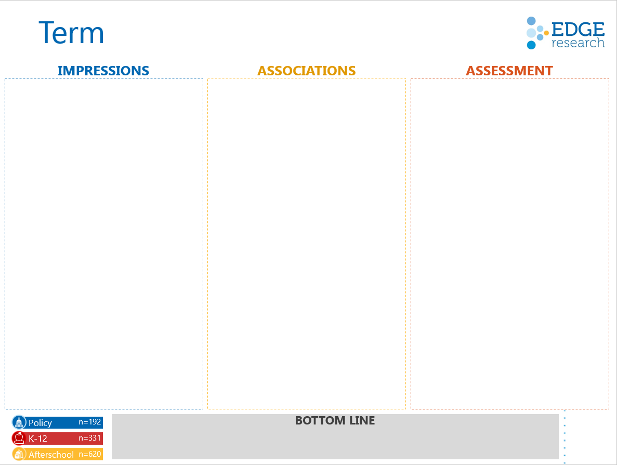
Survey Testing
General impressions –
positive/negative (5 pt. scale)
After Wallace definition –
most descriptive; most natural language; most motivating (pick 1)
Connotations –
partisan leanings;
term of past vs. term of future;
system approach vs. individual program (slide rule ratings)
On reflection –
term you prefer (pick 1);
terms to avoid (multi-select)
Online Survey of 1,600
  Policymakers (192)
  K-12 Leaders (331)
  Afterschool Leaders (620)
  Other Stakeholders (457)
Fielded Feb. 23 – March 24, 2016

Slide 16
Topic Defined
The survey offered a working definition from The Wallace Foundation.
Working definition of the topic:
Supporting students to develop emotional intelligence, positive attitudes, persistence, self-management and relationship skills.
These skills can be developed in any setting, at any point in the school day or after school.
Their development can be supported through programs, practices, procedures and policies.
Examples from the field:
Incorporating social and emotional skills into policies for school assessment.
Preparing students to be successful adults.
Programming or curriculum focused on teamwork, persistence and empathy.

Slide 17
Quantitative: Findings on Terms
The survey confirms there is no “silver bullet” term for this topic.
But across the research phases, “social and emotional learning” emerges as one that is familiar and clear for all 3 professional audiences.
Character
Of the terms tested, this got the weakest scores on most dimensions, and the largest number say to “avoid it.”
Success factors
Falls short as an overarching term. But neutrality and urgency of the language suggest could be useful in messaging.
Youth development
This term means something to Afterschool, and Policymakers find it appealing, but it’s unlikely to catch on in K-12, and thus not a strong contender.
Social-emotional and academic learning
A close rival to SEL. Quantitative testing shows this term has similar qualities, plus the advantage of resonating with K-12.
Social and emotional learning
Familiar language that achieves the objective to communicate clearly. Pitfalls are it lacks urgency and is seen as more liberal, though fewest number say to “avoid it.”

Slide 18


SEL vs. SEAL
Social and Emotional Learning vs. Social-Emotional and Academic Learning
Positive Feelings
(top 2 box)
Most Descriptive
(pick 1)
Most Urgent
(pick 1)
Preference
(pick 1)
Term Viewed as
Liberal, Neutral,
Conservative
Policy | K12 | Afterschool
77% | 82% | 88%
Policy | K12 | Afterschool
70% | 81% | 82%
Policy | K12 | Afterschool
33% | 32% | 35%
Policy | K12 | Afterschool
27% | 40% | 27%
Policy | K12 | Afterschool
17% | 16% | 21%
Policy | K12 | Afterschool
24% | 36% | 22%
Policy | K12 | Afterschool
24% | 24% | 33%
Policy | K12 | Afterschool
28% | 39% | 24%
Policy | K12 | Afterschool
53%, 39%, 8% | 54%, 37%, 9% | 56%, 39%, 5%
Policy | K12 | Afterschool
43%, 42%, 15% | 49%, 39%,12% | 40%, 44%, 16%
## bold=statistically significant head 2 head
* = top choice in category
Notes:
Q03: What is your immediate reaction to each of the following terms?
Q04: Based on The Wallace Foundation's definition of the topic, which term is most descriptive? Please choose the term that in your opinion best matches the definition.
Q06: Which term has the most urgency for you and your organization to devote time, attention and other resources? Please choose the term that you find the most motivating.
Q27: Now that you have spent some time going through the survey and thinking about this topic, which term do you prefer? Please select your #1 preferred term:
Q07: Think about your impression of the term XXXX. For each pair of words, select the point on the scale that indicates the degree to which you believe it describes the term, versus the other word. Conservative – Liberal

Slide 19
Parents: Feedback on Terms
  Terms preferred by professionals do well in these focus groups – SEAL & SEL.
  “Life," "skills" and "success" figure prominently when parents speak in their own language.
  Parent feedback reinforces that it is critical to have “academics” reflected and offer a cautionary note on the word “emotional.”
Term | Assessment | Direct Feedback
Social-emotional & academic learning (SEAL) | Top term in most groups, viewed as all-encompassing, emphasizes the connection between emotional well-being and academic success; can happen in and out of school. | “’Academic’ makes it part of the class. I expect my son to learn social, emotional and academic learning combined.” Oakland
Social & emotional learning (SEL) | Same as SEAL for some, but for others the lack of “academic” means this is more of the parents’ responsibility. SEAL & SEL connote and denote the topic. | “Children need this guidance. In order to get the academic learning they need to have the social and emotional.” Boston
Life skills | Professionals did not favor this term, but it was natural language for parents. Taught at home and at school, covers everything from hygiene to respect for others. | “Like an infant needs to learn the basic life skills of the world. When they go to school, these are the basic skills of school: respect the teacher, show up, do the work, etc. It’s a foundation.” Boston
Character | An interesting difference between the parent & professional findings. In these groups, many parents knew the term and perceive it as an essential quality to develop. | “If you have good character, the other stuff will follow. It’s the foundation created for a child. It comes from home before school, then school has a role in supporting it.” Dallas

Slide 20

Frames Tested
Children will benefit.
Making social and emotional skills part of the learning equation will help children succeed in school and life. With social and emotional skills, children can manage emotion, build positive relationships and navigate social environments. When adults focus on helping children develop these skills and are supported by good policies and training, children are better prepared for the world and able to fulfill their potential.
GAIN
We can make a real difference.
Leaders in education and youth development can have a profound effect on the next generation by prioritizing social and emotional support. When students feel loved, nurtured and safe -- those students are willing to take risks for learning in school, afterschool and at home. All adults have a role to play in developing the social and emotional skills children need for success in school and life.
EMPOWERMENT
This will help us achieve a larger goal.
By prioritizing the development of social and emotional skills, we can improve future prospects for our children, develop good citizens and support the country’s workforce. Equipping children with crucial social and emotional skills can also play an important role in closing the stubborn achievement gap. For too long social and emotional skills have been pushed out of daily learning experiences for many children. Fostering these skills is a job for everybody, especially those leading our public schools and afterschool programs.
SOLUTIONS
This helps address the problem of inequity.
Children from high-poverty, at-risk neighborhoods have less access to the kinds of enriching experiences that build social and emotional skills crucial for success in school and life. That’s an opportunity gap that we must close in the system, by ensuring that schools and afterschool programs are equipped to help children develop social and emotional skills as well as academic skills.
EQUITY
PREVENTION
Not doing this will cost us later.
Unless schools and afterschool programs prioritize social and emotional learning, disadvantaged children will continue to lag behind their wealthier peers in both academic achievement and life success. If we do prioritize both social and emotional learning along with academics, we can help level the playing field.
d

Slide 21
Quantitative: Frame Preference
d
When forced to choose the most convincing frame, the Gain Frame came out on top with Policy, K-12 and Afterschool leaders.
Notes:
Q23: Of all the arguments, which is the most convincing reason for your system or organization to devote time, attention and resources to this topic?

Slide 22
Parent Feedback: Topic and Frames
Introducing SEL
Framing
  We learned that parents need more warming up to the SEL topic.
  “Self management” and “emotional intelligence” are examples of technical language to avoid. On the other hand, “social skills” and “goal setting” are familiar and appealing.
  Parents want to understand practical application. They are interested in program examples and resist new efforts to “evaluate” their children.
  As with professionals, the GAIN frame is persuasive. Broad themes of “success in school and life” resonate with parents and the field alike.
  A winning element of the EMPOWERMENT frame is the emphasis that “all adults” have a role. “Parents” say they deserve a call out.
  The EQUITY frame continues to have a niche audience. It can alienate -- some parents found it “condescending.”
“Children’s learning starts at home, but also learning at school and afterschool, is a better formation.” Dallas
“All of that [GAIN frame] is what you want for your kids in the end, for them to be happy, healthy, sociable beings.” Boston

Slide 23

Lessons for Framing
What motivates audiences to be involved or supportive of SEL efforts? |  | Gain frame and benefits to children. Professionals and Parents respond positively to children being “prepared” and ready to meet their “potential.”
How do we talk about this when there is no generally accepted vocabulary? |  | Specifics and program examples: “manage emotion, build positive relationships, navigate social environments;” and always in tandem with academic learning.
What are ways to customize the message by audience? |  | *All adults have a role (K-12, Afterschool, Parents) *Learning equation (for all) *Good citizens (for Policy) *Closing the opportunity gap (for some)
How far can we go in communicating the problem or potential benefit? |  | Be careful. Across audiences, push back on “prevention” and “solutions” frames gives reason to temper communication.
What are we really asking for? |  | For leaders to make SEL a “priority.” For parents to support SEL for “all children.” These messages build awareness and urgency.

Slide 24
More on Communicating with Parents
Focus groups suggest ways to tune the SEL message for parents.
Dos
Don’ts
Stress the complement to academics:
“the learning equation”
“beyond academics”
“in addition to”
“for school, for life”
Frame the big picture:
“helping students”
“succeed”
“all students” benefit
“fulfill potential”
“life lessons”
Acknowledge all roles:
adults, home, school, afterschool
Start with familiar skills to build up the case
Leave parents out
(directly or indirectly)
Stress “emotional” over social and academic
Try to create “a priority” over academics
Fast-forward too quickly
to individual assessment or school evaluation
Lead with inequity
(or suggest family insufficiencies)
Overlook the how-to and practical application

Slide 25

Encouraging News
On the Agenda
SEL is a shared priority among these audiences.
Other items on the education agenda are a chance to tune and target the message (but they are not necessarily competing with SEL).
According to respondents, their communities are active and likely to stay engaged on this topic.
Policy
SEL
Training/PD
College & career readiness
Gaps in academic achievement
Program & instructional quality
Leadership development
K-12
SEL
Academic achievement
Gaps in academic achievement
Budget & resources
Program & instructional quality
Student engagement
Afterschool
SEL
Program & instructional quality
Gaps in academic achievement
Family engagement
Training/PD
Summer learning
(Top 6 priorities rank ordered, respondents could select up to 3 priorities out of 16)
Notes:
Q14: Where would you say this topic ranks right now among your organization’s priorities?
Q02: What issues are at the top of your education agenda right now? Please select up to 3 top priorities (out of 16).

Slide 26
Work to Do
4 in 5 say adults will need a lot more training and professional development to address this topic
Audiences appear primed, but not mature, in their system support of SEL.
The biggest barrier is that adults will need a lot more training to address SEL.
Audiences also say the topic is more complex than many people imagine.
Half say their system has efforts “in process” on this topic
Policy (81%)
K-12 (77%)
Afterschool (78%)
Policy (56%)
K-12 (55%)
Afterschool (55%)
Notes:
Q15: Below are some statements about the topic. How much do you agree or disagree with each?
Q25: Some people are concerned about how efforts around this topic will actually work. How much do you agree or disagree with the following statements about this topic?

Slide 27
Social and Emotional Learning: Feedback and Communications Insights from the Field
Findings from desktop research

Slide 28
Desktop Research Methodology
A multi-pronged approach:
1
Reviewed 25+ documents from Wallace
2
Used text analytics and Google trends data to identify frequency of terms and related terms
3
Additional scans of online content from
12 policy and educational organizations
4
Reviewed 10 school systems recognized as leaders in SEL to assess their language
5
Consolidated and analyzed data to recommend a list of terms to be used in the qualitative phase

Slide 29
40+ Terms Circulating
21st century skills/competencies Academic attitudes and behaviors Academic mindsets Achievement behavioral skills Capacity for accomplishment Character (variations: character education character development; character building; and character virtue development) Deeper learning Developmental experiences Effective Learner Emotional Intelligence Ethics Expanded learning system Foundations for Young Adult Success | Grit Growth mindset Intrapersonal and interpersonal competencies Learning mindset Life skills Multiple dimensions of learning Non-academic skills Non-academic success factors Non-academic youth outcomes Non-cognitive traits & habits (variations: non-cognitive skills/factors; non-cognitive learning; non-cognitive development) Personal and social skills Personal success skills Positive youth development Productive persistence Prosocial behavior/experiences
School climate Science of human development Skills for agency Social-emotional learning (variations: social-emotional development; social-emotional competence; social and emotional skills; social emotional competencies) Social, emotional and mindful learning Soft skills Student agency Student-centered learning The Big Five Thriving Transferable knowledge and skills Whole Child Approach Youth development

Slide 30
And 40+ Years of Study
Google Scholar shows the conversation starting in the ’60s
Journal articles increase significantly around Y2K
Since a spike in 2010, there has been some tapering off

Slide 31
Frequency: Google Trends
As with scholarship, the web landscape gets more cluttered in the last 10 years
Soft skills
Character development
21st Century Skills
Positive Youth Dev.
SEL
Academic Attitudes
Whole Child Dev.
Behavioral Skills
Growth mindset
Note: “Non-cognitive” too low frequency to analyze; “Grit” too many unrelated items to include

Slide 32
Leading Terms & Connotations
Emphasis on self: | Emphasis on action: | Beyond self & actions:
Mindset: academic, learning, growth Character Grit Academic attitudes | Non-cognitive Soft skills 21st century skills Behavioral skills Academic behaviors | Whole child development Youth development Social and emotional

Slide 33
Different definitions, similar outcome
=
Success beyond academics
“… create more engaging schools and prepare students for the challenges of the world.”
–Roger Weissberg
“…strong effects on educational attainment, but have additional effects on important life outcomes…” –OECD
“…young people can fulfill individual goals and have the agency and competencies to influence the world around them.”
-CCSR

Slide 34
Language Shift Underway
From:
To:
Process |  | Outcomes
Semantic differences |  | Unifying meaning
A term with limitations |  | A term with flexibility
Programmatic add-ons |  | Integration
Having a sidebar conversation |  | Changing the student success narrative
Notes:
Sources:
Education Week Research Center. (2015). Social and Emotional Learning: Perspectives from America’s Schools
Farnham, L. et al. (2015) Rethinking How Students Succeed. Stanford Social Innovation Review. Retrieved from http://ssir.org/up_for_debate/article/rethinking_how_students_succeed
Raikes Foundation. (2015). Learning Mindsets & Skills: Insights and Ideas from Message R&D (presentation)
Parthenon. (2015). Non-Academic Youth Outcomes Funder Collaborative June Convening (presentation)
Parthenon. (2015). Non-Academic Youth Outcomes Funder Collaborative Convening Pre-Read (presentation).
Weissberg, R. P., & Cascarino, J. (2013). Academic learning + social-emotional learning = national priority. Phi Delta Kappan. 95 (2): 8-13.

Slide 35
Detailed Findings

Slide 36
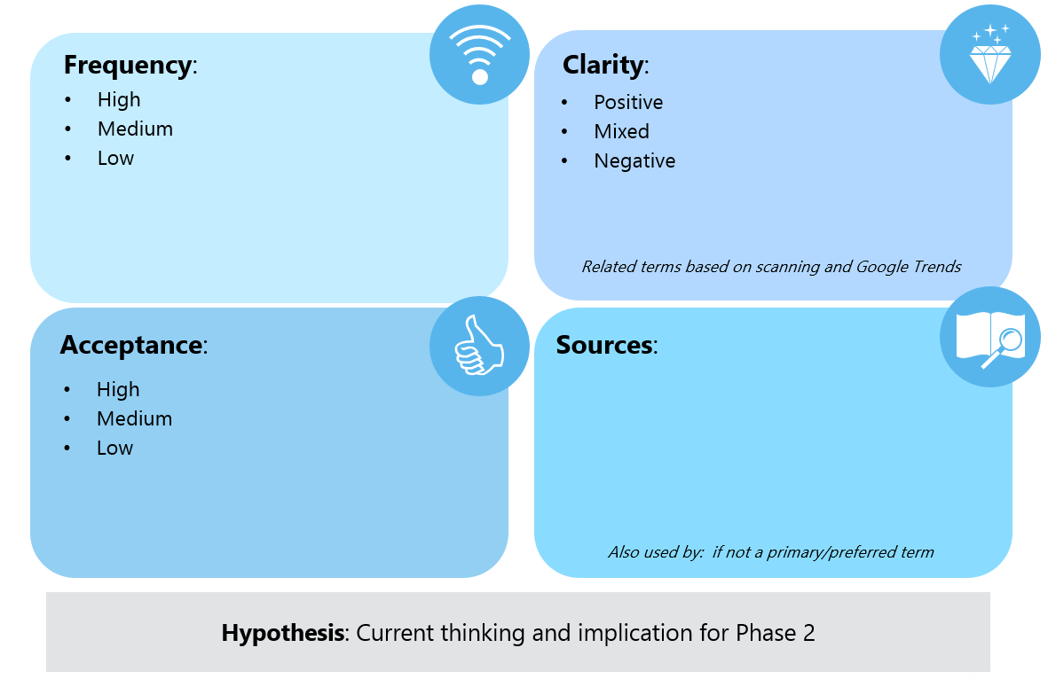
Dimensions for Analysis
Qualitative analysis based on all desktop sources consolidated
Not intended to be the last word on any of the terms
For generating hypotheses and discussion with Wallace to inform the next phase of research – qualitative interviews

Slide 37
21st Century Skills
Frequency: High
Clarity: Mixed
Appears regularly in Wallace background
Term-of-choice for other players
High frequency across media (searched more than “social and emotional learning” or “school climate”)
High frequency since 2006, only “soft skills” is searched more in Google
Broad meaning (academics, development)
Refers to variety of skills young people need to be successful in school, work, life
Strong links to outcomes (digital, career)
Starting to feel dated?
Related: digital literacy, global citizenship,
workforce development
C
Acceptance: High
Sources: Many
Policy & Business audiences seem to
like the term
Educators use it
Some pushback that evaluation of these programs is mixed
Partnership for 21st Century Learning
U.S Department of Education
AIR
The Heritage Foundation
Also used by: Edutopia, EdWeek, AASA
Hypothesis: Existing term with a lot of positives. But it is strongly associated with a few organizations and seems broader than what is intended for this initiative.

Slide 38
Soft Skills
Frequency: High
Clarity: Mixed
Appears regularly in Wallace background
High frequency across media (most searched on Google since 2004)
Used most among Business leaders
Used by the US Department of Labor to describe skills for workplace success
Broad; very workplace/future oriented
Refers to a variety of non-technical skills young people need to be successful in school, work, and life, ranging from creativity to punctuality
“Soft” is vague and diminishes importance
Related: project-based learning, skills for success, behavioral skills, applied skills
C
Acceptance: High
Sources: Many
Business audiences use the term
Educators use it to describe skills learned through observation and experience
Little to no pushback on the term
But are we talking about learning to balance a checkbook or collaborate with a team?
American Enterprise Institute
Brookings Institute
NPR
Edutopia
Hypothesis: Widely used and accepted term, especially in the business world,
but “soft” downplays importance for education systems.

Slide 39
Social and Emotional
Frequency: High
Clarity: Mixed
Often used in Wallace background
Middle of the pack in Google searches; trends match “21st century skills” and “school climate” searches
Education community & Think Tanks use this term frequently; Policy community has many other terms in circulation
“Social” and “emotional” are relatable (although not always recognized as qualities to be learned or taught)
Narrow but still inclusive; many variations
Strong connections to development; school climate can make this seem niche
Related: non-cognitive, social skills, early childhood,
emotional development, readiness
C
Acceptance: TBD
Sources: Many
No detractors that we can see
Not a lot of political will or urgency either
In EdWeek’s online survey, other factors ranked higher in driving achievement
Can’t forget that SEL has to be linked with academics (can feel like an add-on)
CASEL
NSCC
Edutopia
NEA
NCSL
NLC
Brookings
Heritage Foundation
RAND
Leading school districts
Also used by: AASA, AIR, Bechtel Foundation
Hypothesis: Comfortable term but may lack urgency. Will it really motivate policy & education decision makers?

Slide 40
Grit
Frequency: Medium
Clarity: Mixed
Appears somewhat frequently in Wallace background
Very low frequency in press and trends searches
Middle of the pack for scholarly sources
Relatively limited in what it covers-tied to pioneer spirt of perseverance, less about communication and teamwork
Seen as a subset of social-emotional learning
Used generally as a quality for success
Related: resilience, growth mindset, perseverance
C
Acceptance: Medium
Sources: Some
Considered a very American quality-generally embraced
Originators of the term warn that it is not all-encompassing and may be a fad
Clearly tied to cognitive control
AIR
The Heritage Foundation
NPR
University of Pennsylvania, Angela Duckworth
Also used by: Edutopia
Hypothesis: Not broad enough for Wallace meaning.

Slide 41
Growth Mindset
Frequency: Medium
Clarity: Mixed
Used regularly in Wallace background
“Mindset” has a lot of traction
Doesn’t seem to be THE preferred term anywhere; usually appears with others
Middle in Google searches, upward tick
Not as prominent as other terms in headlines and blogs
The belief that “ability can change and comes from hard work and perseverance”
Implies efficacy, tangible outcomes
Raikes found that “learning mindsets” was more understandable and not limited to the classroom
Related: learning mindset, fixed mindset
C
Acceptance: Medium
Sources: Few
Seems to have caught on in Business & Education communities
Concern it is being used to justify “positive thinking” and “intuition”
Stanford, Carol Dweck
AIR
Also used by: EdWeek, National Education Association
Hypothesis: Risk in being over-used and misinterpreted. “Learning mindset” seems more promising than adopting this as an overarching term.

Slide 42
Whole Child Development
Frequency: Medium
Clarity: Mixed
Prominent in Wallace’s own materials, but not all the background
Medium frequency in Google Scholar
Low use for search
Broad, encompassing, positive
Strong connections with health, as in aligning schools, public health and school health to improve both learning and health
PBS Series “The Whole Child” and the related textbook by Joanne Hendrick, Ph.D appear often in online searches
Related: total child, whole student
C
Field leader interviews showed broad consensus for focus on whole child development
May currently mean more to the Health community than the Education community
Associations with ASCD’s “Commission on the Whole Child” may leave a partisan tone
Acceptance: Medium
Sources: Few
Wallace Foundation
CDC
Maryland State Department of Ed.
Also used by: AASA, NEA
Hypothesis: Worthy of continued exploration. Is this term reinventing itself?

Slide 43
Character
Frequency: Medium
Clarity: Negative
“Character” is used regularly in discussions of the topic, less so as a synonym for SEL in Wallace background
Low frequency in Google Scholar (not the primary focus of study?)
Medium frequency in search and news; stood out more in early 2000s when there were fewer terms in the landscape
Fundamental qualities that make people good citizens
Debate over how much is inherited, how much can be learned
Many variations of the term
Related: character education/development/building, responsibility, creative writing
C
Acceptance: Low
Sources: Few
Moral/religious connotations
More marketing than evidence based practice? (example: Topeka KS: “Real Encounter” high school programs)
Is this learned? What is the call to action?
Bechtel Foundation
John Templeton Foundation
KIPP Charter Schools
NAA
Also used by: AASA, Edutopia, EdWeek,
Heritage Foundation
Hypothesis: Among the more controversial terms. But helps describe SEL in action.

Slide 44
Non-Cognitive
Frequency: Mixed
Clarity: Negative
Appears repeatedly in Wallace background
But low frequency across media; among the lowest searched
Very low frequency since 2004, not enough to analyze via Google trends
Extremely broad, covering a range of skills, traits, and behaviors
It can be difficult to decipher to what precisely it refers
Misleading as all skills involve cognition
Related: non-cognitive traits and habits, non-cognitive factors
C
Acceptance: Low
Sources: Limited
High use by researchers and scholars
Creates a false conflict; even social and emotional skills are cognitive
Starts a conversation about what’s lacking, instead of what can be gained (the positive)
Some pluses: not controversial (less pushback than other terms); a more scholarly term suits some audiences
UChicago
Brookings Institute
AIR
Heritage Foundation
Economic Policy Institute
Also used by: NGA, American Enterprise Institute,
SSIR, OECD, CCSR
Hypothesis: Captures a wide range of skills and traits, but it is vague and the implications can be misleading. Invites criticism.

Slide 45
Positive Youth Development
Frequency: Low
Clarity: Positive
Some mentions in Wallace background, including Wallace’s materials
Very low compared to other terms in numbers of Google searches
Low frequency in Google Scholar or Yahoo news
Outcome based, aspirational language
Broad interpretations that can include academics and learning
Implies teens more than elementary age?
Related: afterschool/out of school time,
sports and coaching
C
Acceptance: Medium
Sources: Few
Not a hugely popular term
But used in multiple circles (Education, Policy, Think Tanks, OST)
Does it compel support and action?
Wallace Foundation
NSCC
Also used by: EdWeek, NGA, National 4-H, RAND
Hypothesis: Potentially a uniting term. It is broad; it can include academics or not; and it suggests a return on investment.

Slide 46
Academic Attitudes
Frequency: Low
Clarity: Negative
Low frequency in Wallace background
Only appears in Google searches recently (since 2012)
Very few headlines or blogs featuring
Usually described as a combination of characteristics and habits (sometimes a subset of youth development)
Often pitted against social and emotional skills (a negative in this project)
Related: academic attitudes and behaviors
C
Acceptance: Medium
Sources: Few
No apparent controversy
(or champions) in this scan
Consortium on Chicago School Research
Also used by: Heritage Foundation
Hypothesis: At odds, or at least not broad enough, for this initiative.

Slide 47
Behavioral Skills
Frequency: Low
Clarity: Negative
Frequently used to address improving problem behavior
Some teachers discuss modelling good behavior to their students
Not often discussed among academics
Infrequent mentions in Wallace background
High frequency in scholarly sources since 2009, though with very broad implications
Few mentions in press sources
Related: Achievement Behavioral Skills (ABS), cognitive behavioral skills, social skills training , Positive Behavioral Interventions and Supports (PBIS)
C
Acceptance: Low
Sources: Few
Mostly used to address behavior that impedes learning or the learning of others
Also used in special education
Low connection to Wallace meaning
Sociology of Education
National Education Association
U.S. Department of Education’s Office of Special Education Programs
Hypothesis: Infrequently used term with little connection to intended meaning.

Slide 48
Term Inventory
C
 | Frequency | Clarity | Acceptance | Sources
21st Century Skills | High | Mixed | High | Many
Soft Skills | High | Mixed | High | Many
Social and Emotional | High | Mixed | To be determined | Many
Grit | Medium | Mixed | Medium | Some
Growth Mindset | Medium | Mixed | Medium | Few
Whole Child Development | Medium | Mixed | Medium | Few
Character | Medium | Negative | Low | Few
Non-Cognitive | Mixed | Negative | Low | Limited
Positive Youth Development | Low | Positive | Medium | Few
Academic Attitudes | Low | Negative | Medium | Few
Behavioral Skills | Low | Negative | Low | Few
Key: Higher, Middle, Lower

Slide 49
Perceptual Map
*Whole Child Development
*Soft Skills
*Social and Emotional
*Character
*Grit
*21st Century Skills
*Positive Youth Development
*Behavioral Skills
*Non-Cognitive
*Growth Mindset
*Academic Attitudes
High frequency
Development
Academics
Low frequency

Slide 50
Social and Emotional Learning: Feedback and Communications Insights from the Field
Findings from qualitative interviews

Slide 51
Methodology
45 In-Depth Interviews
Representing key stakeholders
  K-12 Leaders (13)
  Afterschool Leaders (16)
  Policymakers (14)
  Thought Leaders (2)
Sources recommended by Wallace and Wallace Communications Partners
Most interviews 45 minutes to 1 hour: 40+ hours of discussion
Completed Oct. 21 – Dec. 7, 2015
Key Question Areas:
SEL context (direct questions and storytelling technique)
Terminology (open-ended, then discussing select terms)
Outcomes and future outlook (to provide inputs for messaging)
Note: Qualitative findings are not projectable to audiences at large, but they are valuable for insight and to inform the survey phase.

Slide 52
Qualitative Findings
All of these terms have pros and cons; There is no silver bullet
Audiences use an array of terms, often interchangeably
Many acknowledge the clutter and seek a common vocabulary
Feedback makes it easy to eliminate some terms (ideological, pitfalls)
Finalist terms are broad (they link the topic to the larger education landscape; a potential risk is that priorities get lost)
With any terms, will need messaging to impart meaning
“Social and emotional support is how we basically refer to it at school. Sometimes we call it character development.” K-12
“We talk about SEL, young adult success, youth development. The Department of Education mentions academic and personal behaviors, college and career readiness.” Afterschool
“People use 21st century skills, social and emotional learning and youth development.” Policymaker

Slide 53
Finalist Terms in Qualitative
These terms had more potential to be effective than others. However, all had pitfalls.
Social and Emotional Learning
Conveys the right subject matter and is used often in K-12 and Afterschool.
Some feel the phrase lacks urgency.
Whole Child Development
Provides an opening to talk about SEL, but much broader. Of the four finalist terms, this is probably the most ideological and divisive.
Success Factors
Sets the right tone for shared goals, qualities to nurture in a student.
However, it’s generic and not an obvious bridge to talking about SEL.
Youth Development
The epitome of a “widely accepted” term and often preferred. But it might be hard to energize target audiences around an idea so familiar and broad.

Slide 54
Landscape of Terms

Slide 55
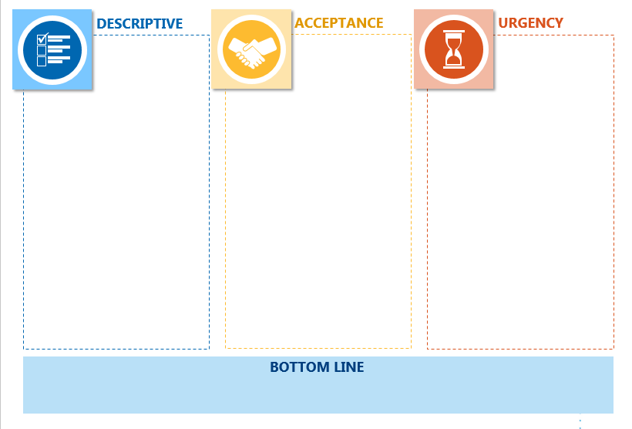
How to Evaluate?
How descriptive - clarity and match to Wallace concept
How widely accepted - across various communities, if any negatives
How urgent – if motivating,
will it spur action?
Pros, cons and associations
Bottom line to date

Slide 56
Social and Emotional Learning
✓
DESCRIPTIVE
ACCEPTANCE
URGENCY
Covers a wide range of skills including self-management, conflict resolution, teamwork
Broadest interpretations include mental health supports and services
Some sources point out the important difference between social learning and emotional learning
Some difference in interpretations of social and emotional “learning” and “development”
Leading term in use today; default term for many
Acceptable to all three stakeholder audiences
At the same time, sources say the phrase is too much like jargon
Politically neutral, but talking about “emotions” gives some a liberal feel
“Learning” can be uniting (active, intentional)
Buzzword “of the moment” for Afterschool and some K-12 leaders
An open question is whether it will resonate with a wider audience
(e.g. policy, parents)
Can feel “too touchy feely” to be a priority for policy
Overall, lacks urgency
BOTTOM LINE
Conveys the right subject matter and is used often in K-12 and Afterschool.
But the phrase can be seen as “jargon” and lacks some urgency.

Slide 57
Social and Emotional Learning
Heard in interviews with professionals…
“Right now social and emotional learning is gaining a lot of popularity and with that a lot of possibilities.” Afterschool
“If I say social and emotional learning, you need an explanation almost immediately, if you are someone not in the field.” Policymaker

Slide 58
Whole Child Development
✓
DESCRIPTIVE
ACCEPTANCE
URGENCY
Accounts for all aspects of a child’s growth: academic, physical, social and emotional
“Holistic” approach to learning
May or may not include basic needs: food, shelter
Sources say this concept is much bigger than SEL (social and emotional learning would be a component under it)
The conventional meaning helps tie SEL to academics
“Child” implies young students (K-8)
Many in interviews say it is a “progressive” concept, linked to “liberal” ideology
Some respondents raise a red-flag saying critics will argue this is beyond the role of schools
More than one source criticizes this term as jargon
“Old” term but robust
Many favorable toward it
Preconceived notions (people attach their own meanings – positive and negative)
Overuse is a concern (a reason to tune out)
Expansiveness is a concern (taking us away from the practice of SEL)
BOTTOM LINE
Provides an opening to talk about SEL, but much broader. Of the four finalist terms, this is probably the most ideological and divisive.

Slide 59
Whole Child Development
Heard in interviews with professionals…
“I haven’t heard much of that lately. When we were having significant budget issues, 10 to 15 years ago, it was a buzzword. I think ‘less conservative’ is the perception.” K-12
“Right now there is some political pushback when you use the term whole child, because there is a connotation that schools and non-profit organizations are delving into areas where they shouldn’t.” Policymaker

Slide 60
Success Factors
✓
DESCRIPTIVE
ACCEPTANCE
URGENCY
Puts the focus on outcomes and benefits (more than approach or practice)
Implies long-term: college and career readiness more so than other terms
Competing definitions of “success” make it vague
Calls attention to “deficits” often environmental:
What does success mean? Can students defy the trend and expectations?
Success means different things to different people; K-12 see it as test scores, Afterschool tend to see it more in the realm of SEL
A new term – has currency, but is still being defined
Heard more in K-12 than Afterschool or Policymaker interviews
Sources are enthusiastic about this term - everyone cares about success
“Starting to catch on” since Department of Ed started using this language
Gets leaders thinking about what makes people successful
While they perk up at the language, it is also generic, and it takes a transition message to get to SEL
BOTTOM LINE
Sets the right tone for shared goals, qualities to nurture in a student.
However, it’s generic and not an obvious bridge to talking about SEL.

Slide 61
Success Factors
Heard in interviews with professionals…
“Success factors is broadening out the kinds of skills, beliefs, mindsets that we think are important. We know that academics alone don’t predict success very well. I think it is improved language.” Afterschool
“What does ‘success’ mean? I like to say it’s a very westernized way of thinking. Who gets to determine what is success? It’s not usually the marginalized and communities of color.” K-12

Slide 62
Youth Development
✓
DESCRIPTIVE
ACCEPTANCE
URGENCY
Is a crowd-pleasing term with a wide variety of definitions
According to sources, it includes SEL, providing opportunities to students
“More than reading and math” is a common way to explain it
Most closely affiliated with Afterschool; but K-12 and Policymakers embrace the term in these interviews
A pitfall is that it seems to imply older “youth”
(tweens and teens)
Politically neutral and versatile: can evoke responsibility (appealing to conservatives) or independent thinking (appealing to liberals)
Familiar language, but no real urgency, it might be difficult to rally support
Risk in being too familiar, something these audiences already know and do
That some communities are adopting this term now might suggest new interest
It is consistently appealing, often preferred in these interviews
BOTTOM LINE
The epitome of a “widely accepted” term and often preferred. But it might be hard to energize target audiences around an idea so familiar and broad.

Slide 63
Youth Development
Heard in interviews with professionals…
“It reminds us there is a bigger picture than reading and math.
It doesn’t have any real negative connotations from my perspective.” Policymaker
“Youth development could be a segment of SEL. It’s very targeted and very focused on a set of specific things that are associated with helping kids mature and grow.” K-12

Slide 64
Less Effective Terms
✓
Term | Descriptive | Acceptance | Urgency | Bottom line
21st century skills | Used loosely and with multiple meanings. | Heard or used by all audiences and business leaders. Rejected by many who see it as dated and/or gimmicky. | Relevant to today’s world. What kids need now (or needed 10 years ago). | A lot of unrelated connotations (tech, workforce, funding). At worst “old hat.”
Character | Morals, ethics, positive social interaction, compliance, respect, responsibility, civic duty. | Everyone understands it. More appealing to conservatives. | Unclear if this is education’s job—overstepping family role? Dated for some. | Ideological red flags: “moral” implications, “religion,” “elitism.”
Soft skills | Emotional intelligence, communication and relationships - things that can’t be graded. | Used by some educators, afterschool and business community. | “Soft” diminishes importance and urgency. | Too many strikes against this term. Many sources say they won’t use it.
School climate/ culture | Conditions in which school and SEL happen, safety, discipline. | Alienates afterschool. | A related and important concept - necessary for SEL to occur and a result of SEL. | Too broad to be the lead term. Exclusive to schools.
Essential life skills | Basic skills for daily living (i.e. budgeting), prep for work and life. | Not widely used; not preferred over other terms. | Necessary to succeed in life, but possibly not education’s responsibility. | Implies a value judgement that’s a turn off, us v. them.

Slide 65
Today’s Mindset

Slide 66
Policymaker Perspective
“We are working to address academic achievement gaps and the opportunity gap in higher poverty, low performing areas.”
Policymaker
“Federal policymakers are intellectually interested, but it’s difficult to measure so they are apt to step back…. State policymakers are showing growing interest.” Policymaker
Policymakers in these interviews discuss social and emotional learning as a way to address big picture problems (literacy, accountability, achievement)

Slide 67
K-12 Perspective
“We’re still in an environment of testing and high stakes accountability. The pendulum is swinging back, but heavy stress on academics pushes this to the side.” Thought Leader
“We are a Title I Elementary School in transformation. We got interested in SEL during the transformation. It is very expensive to execute. We found we needed to work with the private sector.”
K-12 Leader
K-12 leaders in these interviews say that achievement is always at the forefront (grade level performance, grad rates, gaps, Common Core)
Social and emotional learning is gaining in priority but still aspirational

Slide 68
Afterschool Perspective
“Afterschool is the sweet spot for this. It’s not as high stakes as the school day. It fosters self expression, creativity, and relationship building.“
Afterschool Leader
“For me this raises the issues of staff training, emotional intelligence and dealing with kids who have behavioral issues. The number of kids with social and emotional issues is increasing.”
Afterschool Leader
Afterschool leaders in these interviews tell us that social and emotional learning is inherent in their programs (emotional, behavioral, social skills)

Slide 69
Shared Visions of Success
Themes emerged as leaders described their vision of SEL success.
Question: What does it look like when we are supporting students in their social and emotional development and doing it well?
Feeling Safe
“When students feel loved, nurtured and safe, they are willing to take risks in their learning. When they are provided student-friendly processes to communicate, and those conversations happen daily.” K-12
Caring Adults
“In the classroom teachers are using preventative measures.
And it’s a two-way street with parents. When incidents flare up they can address them. It’s in-class and afterschool.” Policymaker
Learning
Tailored
“It’s not one size fits all. The teacher or staff member understands the need of the student, and is doing their best to meet those needs so the child can learn.” K-12
Heroes in Life
“Here’s a kid that was a little shy and nerdy, but when you talk about robotics he glows… It’s about responsibility, learning what you’re good at, and when we’re successful they really sparkle.” Policymaker
Relating to Others
“Two kids run for one swing. One gets angry. One gets sad. What’s the response? They can use the peace path. A staff member comes over. They compromise.” Afterschool

Slide 70
Messaging Opportunities

Slide 71
Possible Framing Options
Edge developed framing themes based on qualitative analysis.
These ideas were refined with Wallace for survey testing.
Gain Frame
Prevention Frame
Solution Frame
Empowerment Frame
“Better outcomes academically”
“Life and coping skills”
“Develop happier and healthier people”
“Health outcomes”
“Learning plus”
“Children are stronger and more successful when challenged”
“In the world we’re living in, can’t afford not to care about it”
“15% of my students cannot learn in a traditional environment”
“Toxic stress”
“Beyond testing and drilling”
“College and career readiness”
“Workforce and future of the nation”
“The research shows it helps all students, and especially urban and low income”
“A way to solve the motivation gap”
“Brain research shows the brain changes”
“Need to live it and represent it”
“Danger in thinking it’s already done”
“Gives students voice and choice”
“Collective impact – educators, nonprofits, communities”
“Build relationships w/ peers and adults and the walls came down”
Positive benefits of investing in SEL
Cost of doing nothing is often more motivating
Always a winner in behavioral economics research
Conveys agency and shifts the focus to implementation

Slide 72
Social and Emotional Learning: Feedback and Communications Insights from the Field
Findings from quantitative surveys

Slide 73
Methodology
Online Survey of 1,600
Professionals in key roles
  Policymakers (192)
  K-12 Leaders (331)
  Afterschool Leaders (620)
  Other Stakeholders (457)
Respondents identified through Wallace lists and Wallace Communications Partners (20+ organizations)
Fielded Feb. 23 – March 24, 2016
Key Question Areas:
Terminology & foundational language (5 terms)
Context – knowledge, attitudes, barriers, information sources related to SEL
Testing frames & messaging language (5 frames)
Demographics

Slide 74
Quantitative: Findings on Terms
The survey confirms there is no “silver bullet” term for this topic.
But across the research phases, “social and emotional learning” emerges as one that is familiar and clear for all 3 professional audiences.
Character
Of the terms tested, this got the weakest scores on most dimensions, and the largest number say to “avoid it.”
Success factors
Falls short as an overarching term. But neutrality and urgency of the language suggest could be useful in messaging.
Youth development
This term means something to Afterschool, and Policymakers find it appealing, but it’s unlikely to catch on in K-12, and thus not a strong contender.
Social-emotional and academic learning
A close rival to SEL. Quantitative testing shows this term has similar qualities, plus the advantage of resonating with K-12.
Social and emotional learning
Familiar language that achieves the objective to communicate clearly. Pitfalls are it lacks urgency and is seen as more liberal, though fewest number say to “avoid it.”

Slide 75
Encouraging News
On the Agenda
68%
66%
82% priority
SEL is a shared priority among these audiences.
Other items on the education agenda are a chance to tune and target the message (but they are not necessarily competing with SEL).
According to respondents, their communities are active and likely to stay engaged on this topic.
Policy
SEL
Training/PD
College & career readiness
Gaps in academic achievement
Program & instructional quality
Leadership development
K-12
SEL
Academic achievement
Gaps in academic achievement
Budget & resources
Program & instructional quality
Student engagement
Afterschool
SEL
Program & instructional quality
Gaps in academic achievement
Family engagement
Training/PD
Summer learning
(Top 6 priorities rank ordered, respondents could select up to 3 priorities out of 16)
Notes:
Q14: Where would you say this topic ranks right now among your organization’s priorities?
Q02: What issues are at the top of your education agenda right now? Please select up to 3 top priorities (out of 16).

Slide 76
Work to Do
4 in 5 say adults will need a lot more training and professional development to address this topic
Audiences appear primed, but not mature, in their system support of SEL.
The biggest barrier is that adults will need a lot more training to address SEL.
Audiences also say the topic is more complex than many people imagine.
Half say their system has efforts “in process” on this topic
Policy (81%)
K-12 (77%)
Afterschool (78%)
Policy (56%)
K-12 (55%)
Afterschool (55%)
Notes:
Q15: Below are some statements about the topic. How much do you agree or disagree with each?
Q25: Some people are concerned about how efforts around this topic will actually work. How much do you agree or disagree with the following statements about this topic?

Slide 77
Lessons for Framing
What motivates audiences to be involved directly as partners or as knowledge users? |  | Gain frame and benefits to children; children will be “prepared” and ready to meet their “potential.”
How do we talk about this when there is no generally accepted vocabulary? |  | Specifics engage these professionals: “manage emotion, build positive relationships, navigate social environments.”
What are ways to customize the message by audience? |  | *All adults have a role (K-12, Afterschool) *Learning equation (for all) *Good citizens (for Policy) *Closing the opportunity gap (for some)
How far can we go in communicating the problem or potential benefit? |  | Be careful. Push back on “prevention” and “solutions” frames gives reason to temper communication.
What are we really asking for? |  | For leaders to make SEL a “priority.” The language of “priorities” and “prioritizing” helps build urgency.

Slide 78
Terminology

Slide 79
Survey Testing
General impressions –
positive/negative (5 pt. scale)
After Wallace definition –
most descriptive; most natural language; most motivating (pick 1)
Connotations –
partisan leanings;
term of past vs. term of future;
system approach vs. individual program (slide rule ratings)
On reflection –
term you prefer (pick 1);
terms to avoid (multi-select)
* = top choice in the category
for this audience
## bold = statistically significant
gr = low agreement on
this connotation
##
Notes:
“The topic of this survey goes by many different names. Below is a working definition provided by The Wallace Foundation. Please read the definition carefully, and then we have some questions about language. (Any time you see the word topic highlighted in blue in the survey, you can scroll over or click it to see the definition again.)
Working definition of the topic:
Supporting students to develop emotional intelligence, positive attitudes, persistence, self-management and relationship skills.
These skills can be developed in any setting, at any point in the school day or after school.
Their development can be supported through programs, practices, procedures and policies.
Examples from the field:
Incorporating social and emotional skills into policies for school assessment.
Preparing students to be successful adults.
Programming or curriculum focused on teamwork, persistence and empathy.”

Slide 80
Character
IMPRESSIONS
ASSOCIATIONS
ASSESSMENT
Liberal |  | Conservative
vs.
8%
57%
18%
42%
15%
47%
(pick 1)
Term Future |  | Term Past
vs.
(pick 1)
12%
61%
19%
58%
21%
55%
(pick 1)
System-Wide |  | Program
“Character is tricky because it can sound like a moral judgment or deficiency, if you say someone doesn't have it, or it can seem like an incrimination of home.” Policy
vs.
27%
54%
48%
33%
(pick 1)
31%
50%
n=192
BOTTOM LINE
Policy
Too many strikes against this term.
A particularly loaded term for Policy.
n=331
K-12
n=620
Afterschool
Notes:
Q03: What is your immediate reaction to each of the following terms?
Q04: Based on The Wallace Foundation's definition of the topic, which term is most descriptive? Please choose the term that in your opinion best matches the definition.
Q05:Which term is the most natural language for you and your organization? Please choose the term that you are most comfortable using.
Q06: Which term has the most urgency for you and your organization to devote time, attention and other resources? Please choose the term that you find the most motivating.
Q27: Now that you have spent some time going through the survey and thinking about this topic, which term do you prefer? Please select your #1 preferred term:
Q29: On the other hand, are there terms The Wallace Foundation should avoid in its communication about this topic? Please mark all that have a negative connotation for you:

Slide 81
Success Factors
IMPRESSIONS
ASSOCIATIONS
ASSESSMENT
Liberal |  | Conservative
vs.
20%
29%
27%
20%
23%
27%
(pick 1)
Term Future |  | Term Past
vs.
(pick 1)
46%
19%
57%
15%
44%
21%
“I have no idea what success factors is – it sounds very jargony.”
Foundation/Funder
(pick 1)
System-Wide |  | Program
vs.
45%
26%
“Success factors are too intertwined with teacher evaluation and student academic performance. This might cause some confusion.” K-12
tied
55%
27%
(pick 1)
45%
32%
n=192
BOTTOM LINE
Policy
Doesn’t fit the bill as an overarching term.
Some positives mean it still has potential for messaging.
n=331
K-12
n=620
Afterschool
Notes:
Q03: What is your immediate reaction to each of the following terms?
Q04: Based on The Wallace Foundation's definition of the topic, which term is most descriptive? Please choose the term that in your opinion best matches the definition.
Q05:Which term is the most natural language for you and your organization? Please choose the term that you are most comfortable using.
Q06: Which term has the most urgency for you and your organization to devote time, attention and other resources? Please choose the term that you find the most motivating.
Q27: Now that you have spent some time going through the survey and thinking about this topic, which term do you prefer? Please select your #1 preferred term:
Q29: On the other hand, are there terms The Wallace Foundation should avoid in its communication about this topic? Please mark all that have a negative connotation for you:

Slide 82
Youth Development
IMPRESSIONS
ASSOCIATIONS
ASSESSMENT
Liberal |  | Conservative
vs.
32%
14%
34%
19%
31%
14%
(pick 1)
Term Future |  | Term Past
vs.
(pick 1)
30%
40%
36%
36%
38%
30%
(pick 1)
System-Wide |  | Program
“Too broad; it sounds like a special education term or negative behavior program; more reactive than pro-active.” K-12
vs.
60%
17%
tied
54%
26%
(pick 1)
64%
18%
n=175
BOTTOM LINE
n=192
Policy
Tried and true language in Afterschool, but not the most preferred.
Works to a degree with Policy, but K-12 resists it.
n=331
K-12
n=620
Afterschool
Notes:
Q03: What is your immediate reaction to each of the following terms?
Q04: Based on The Wallace Foundation's definition of the topic, which term is most descriptive? Please choose the term that in your opinion best matches the definition.
Q05:Which term is the most natural language for you and your organization? Please choose the term that you are most comfortable using.
Q06: Which term has the most urgency for you and your organization to devote time, attention and other resources? Please choose the term that you find the most motivating.
Q27: Now that you have spent some time going through the survey and thinking about this topic, which term do you prefer? Please select your #1 preferred term:
Q29: On the other hand, are there terms The Wallace Foundation should avoid in its communication about this topic? Please mark all that have a negative connotation for you:

Slide 83
Social-emotional and academic learning
IMPRESSIONS
ASSOCIATIONS
ASSESSMENT
Liberal |  | Conservative
vs.
43%
15%
49%
12%
40%
16%
(pick 1)
Term Future |  | Term Past
vs.
(pick 1)
57%
16%
63%
13%
63%
12%
(pick 1)
“Because it's more encompassing and because, ideally, the two types of learning should work together.” K-12
System-Wide |  | Program
vs.
56%
26%
62%
22%
“It is about academic learning also and this might give you more buy-in.” Policy
(pick 1)
58%
25%
n=175
BOTTOM LINE
n=175
n=192
Policy
This latecomer to testing is a viable alternative to SEL,
and popular with K-12.
n=331
K-12
n=620
Afterschool
Notes:
Q03: What is your immediate reaction to each of the following terms?
Q04: Based on The Wallace Foundation's definition of the topic, which term is most descriptive? Please choose the term that in your opinion best matches the definition.
Q05:Which term is the most natural language for you and your organization? Please choose the term that you are most comfortable using.
Q06: Which term has the most urgency for you and your organization to devote time, attention and other resources? Please choose the term that you find the most motivating.
Q27: Now that you have spent some time going through the survey and thinking about this topic, which term do you prefer? Please select your #1 preferred term:
Q29: On the other hand, are there terms The Wallace Foundation should avoid in its communication about this topic? Please mark all that have a negative connotation for you:

Slide 84
Social and emotional learning
IMPRESSIONS
ASSOCIATIONS
ASSESSMENT
Liberal |  | Conservative
vs.
53%
8%
54%
9%
56%
5%
(pick 1)
Term Future |  | Term Past
vs.
(pick 1)
51%
18%
56%
20%
69%
11%
(pick 1)
“Social and emotional learning has an impact on academic learning but needs to be prioritized. Making a distinction between them will emphasize its value.” Afterschool
System-Wide |  | Program
vs.
47%
27%
60%
24%
(pick 1)
59%
24%
n=192
BOTTOM LINE
Policy
Positive and descriptive. Pitfalls are it lacks urgency and is seen as more liberal, though the fewest number say to “avoid it.”
n=331
K-12
n=620
Afterschool
Notes:
Q03: What is your immediate reaction to each of the following terms?
Q04: Based on The Wallace Foundation's definition of the topic, which term is most descriptive? Please choose the term that in your opinion best matches the definition.
Q05:Which term is the most natural language for you and your organization? Please choose the term that you are most comfortable using.
Q06: Which term has the most urgency for you and your organization to devote time, attention and other resources? Please choose the term that you find the most motivating.
Q27: Now that you have spent some time going through the survey and thinking about this topic, which term do you prefer? Please select your #1 preferred term:
Q29: On the other hand, are there terms The Wallace Foundation should avoid in its communication about this topic? Please mark all that have a negative connotation for you:

Slide 85
SEL vs. SEAL
Social and Emotional Learning vs. Social-Emotional and Academic Learning
Positive Feelings
(top 2 box)
Most Descriptive
(pick 1)
Most Urgent
(pick 1)
Preference
(pick 1)
Term Viewed as
Liberal, Neutral,
Conservative
Policy | K12 | Afterschool
77% | 82% | 88%
Policy | K12 | Afterschool
70% | 81% | 82%
Policy | K12 | Afterschool
33% | 32% | 35%
Policy | K12 | Afterschool
27% | 40% | 27%
Policy | K12 | Afterschool
17% | 16% | 21%
Policy | K12 | Afterschool
24% | 36% | 22%
Policy | K12 | Afterschool
24% | 24% | 33%
Policy | K12 | Afterschool
28% | 39% | 24%
Policy | K12 | Afterschool
53%, 39%, 8% | 54%, 37%, 9% | 56%, 39%, 5%
Policy | K12 | Afterschool
43%, 42%, 15% | 49%, 39%,12% | 40%, 44%, 16%
## bold=statistically significant head 2 head
* = top choice in category
Notes:
Q03: What is your immediate reaction to each of the following terms?
Q04: Based on The Wallace Foundation's definition of the topic, which term is most descriptive? Please choose the term that in your opinion best matches the definition.
Q06: Which term has the most urgency for you and your organization to devote time, attention and other resources? Please choose the term that you find the most motivating.
Q27: Now that you have spent some time going through the survey and thinking about this topic, which term do you prefer? Please select your #1 preferred term:
Q07: Think about your impression of the term XXXX. For each pair of words, select the point on the scale that indicates the degree to which you believe it describes the term, versus the other word. Conservative – Liberal

Slide 86
Audience Mindsets

Slide 87
Education Agendas: Top Tier
SEL is a top priority, but is only significantly higher than other items for Afterschool.
Other priorities reflect audience roles as expected.
Everybody cares about achievement gaps and program quality (some about training).
Developing emotional intelligence, positive attitudes & social skills in students
Developing emotional intelligence, positive attitudes & social skills in students
Developing emotional intelligence, positive attitudes & social skills in students
Program and instructional quality
Training/professional dev
Academic achievement
Gaps in academic achievement
Gaps in academic achievement
College & career readiness
Gaps in academic achievement
Budget & resources
Family engagement
Program and instructional quality
Program and instructional quality
Training/professional dev
n=192
Policy
n=331
K-12
n=620
Afterschool
Leadership development
Student engagement
Summer learning
Notes:
Q02: What issues are at the top of your education agenda right now? Please select up to 3 top priorities.

Slide 88
Second Tier Priorities
Some issues associated with SEL rank lower in priority: student engagement, school climate, student assessment.
Student engagement
College & career readiness
Budget & resources
Family engagement
Training/Professional development
Student engagement
Budget & resources
School discipline/climate
Academic achievement
Academic achievement
Family engagement
Leadership development
Summer learning
Student assessment
College & career readiness
School discipline/climate
Leadership development
School discipline/climate
Teacher/staff evaluation
Teacher/staff evaluation
Changing demos
n=192
Changing demos
Changing demos
Teacher/staff evaluation
Policy
n=331
K-12
n=620
Afterschool
Student assessment
Summer learning
Student assessment
Notes:
Q02: What issues are at the top of your education agenda right now? Please select up to 3 top priorities.

Slide 89
Reported Activity
Most survey respondents are active and expect to continue efforts.
Few consider their efforts in the “advanced” stage.
Attention Over the Next Year
Efforts Underway
More attention
Advanced
46% 51% 60%
13%
15%
22%
About the Same
In process
42% 41% 34%
No efforts taken
Just beginning
56%
55%
55%
Less attention
21%
22%
19%
7%
5%
1%
3% 1% 0%
n=192
Policy
n=331
K-12
n=620
Afterschool
Notes:
Q17: In the next year will your system/work environment be giving this topic more, less or about the same amount of attention?
Q16: How would you describe efforts underway on this topic in your system/work environment today?

Slide 90
Efforts Underway
SEL gets individual level attention but far less in system supports.
Professional development is the most common activity of K-12 and Afterschool, but we see later in the survey results it is also the #1 concern.
Individual Actions (More Prevalent)
Systems Change
(Less Prevalent)
n=192
Policy
n=331
K-12
n=620
Afterschool
Notes:
Q18: Which, if any, steps has your system/work environment taken to advance this topic? Please mark all that apply.

Slide 91
Top Concerns
Professional development or training is the most common action to date.
Nevertheless, it is also the top barrier identified for the future.
Top 2 Concerns
Strongly Agree
Top 2 Box
“Adults will need a lot more training and professional development to address this topic.”
“I think this topic is more complex than many people imagine.”
Strongly Agree
Top 2 Box
n=192
Policy
n=331
K-12
n=620
Afterschool
Notes:
Q25: Some people are concerned about how efforts around this topic will actually work. How much do you agree or disagree with the following statements about this topic?

Slide 92
Secondary Concerns
Respondents have some concern that efforts are uncoordinated and that programs will not be prioritized. Few respondents feel this topic is a passing fad, and few express concern about measurement.
% Strongly Agree
Efforts on this topic are siloed and uncoordinated.
Measuring this might have unintended consequences and negative ramifications.
Leadership will not prioritize and invest adequately in this topic
It will be too difficult to measure programming and student competence.
Coordination between schools and afterschool programs on this topic will be very difficult.
I am unclear what efforts on this topic will look like in practice.
Often these programs are too infrequent, or too low-quality, to make a difference for children.
I feel like the interest in this topic may be a fad and may not last.
Other needs take priority over social and emotional supports right now.
n=192
Policy
n=331
K-12
n=620
Afterschool
Notes:
Q25: Some people are concerned about how efforts around this topic will actually work. How much do you agree or disagree with the following statements about this topic?

Slide 93
Framing & Outreach

Slide 94
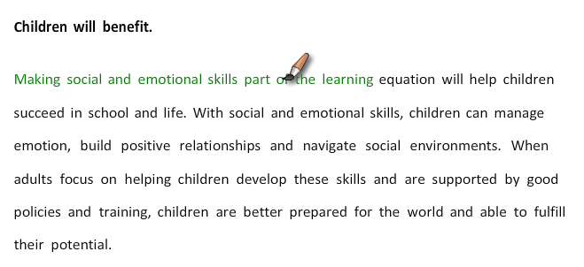
Survey Testing
Audiences assessed each frame on multiple dimensions, providing several ways to evaluate and triangulate responses.
Highlighter Tool Exercise
Open-End Questions
Rankings &
Forced Choice
Positives –
What stands out as positive, effective in making the case on why this is important
Negatives-
What, if anything, bothers you or causes a negative reaction
Urgency–
Extremely motivating/
not motivating at all
(5 pt. scale)
Credibility – Extremely/not at all
(5 pt. scale)
On reflection –
Most convincing reason
to support (pick 1)
Effective language –
Respondents highlight words they “like”, that are effective in making the case for the importance
of this topic
Notes:
Q19: How motivating is this as a reason to prioritize the topic in your organization's policy and practice?
Q20: How credible is this, meaning do you feel as if it is supported by evidence?
Q23: Of all the arguments, which is the most convincing reason for your system or organization to devote time, attention and resources to this topic?

Slide 95
Frames Tested
GAIN
Children will benefit.
Making social and emotional skills part of the learning equation will help children succeed in school and life. With social and emotional skills, children can manage emotion, build positive relationships and navigate social environments. When adults focus on helping children develop these skills and are supported by good policies and training, children are better prepared for the world and able to fulfill their potential.
EMPOWERMENT
We can make a real difference.
Leaders in education and youth development can have a profound effect on the next generation by prioritizing social and emotional support. When students feel loved, nurtured and safe -- those students are willing to take risks for learning in school, afterschool and at home. All adults have a role to play in developing the social and emotional skills children need for success in school and life.
SOLUTIONS
This will help us achieve a larger goal.
By prioritizing the development of social and emotional skills, we can improve future prospects for our children, develop good citizens and support the country’s workforce. Equipping children with crucial social and emotional skills can also play an important role in closing the stubborn achievement gap. For too long social and emotional skills have been pushed out of daily learning experiences for many children. Fostering these skills is a job for everybody, especially those leading our public schools and afterschool programs.
EQUITY
This helps address the problem of inequity.
Children from high-poverty, at-risk neighborhoods have less access to the kinds of enriching experiences that build social and emotional skills crucial for success in school and life. That’s an opportunity gap that we must close in the system, by ensuring that schools and afterschool programs are equipped to help children develop social and emotional skills as well as academic skills.
PREVENTION
d
Not doing this will cost us later.
Unless schools and afterschool programs prioritize social and emotional learning, disadvantaged children will continue to lag behind their wealthier peers in both academic achievement and life success. If we do prioritize both social and emotional learning along with academics, we can help level the playing field.

Slide 96
Frame Preference
When forced to choose the most convincing frame, the Gain Frame comes out on top.
d
## bold=statistically significant
Notes:
Q23: Of all the arguments, which is the most convincing reason for your system or organization to devote time, attention and resources to this topic?

Slide 97
Gain Frame
Rises above the other frames.
Several frames test well, but only the Gain frame speaks to all with credibility and is most convincing in the forced choice.
Respondents highlight more language and have more positive comments than with other frames.
Specific language about SEL skills + general language that children benefit = a winning combination.
“Learning equation” and “success” are concepts to keep in the mix.
This frame is the top choice for all three audiences as the most convincing argument.
RATINGS
(top 2 box)
Credible
(top 2 box)
(pick 1)
n=192
Policy
n=331
K-12
n=620
Afterschool
= top choice in category
Notes:
Q19: How motivating is this as a reason to prioritize the topic in your organization's policy and practice?
Q20: How credible is this, meaning do you feel as if it is supported by evidence?
Q23: Of all the arguments, which is the most convincing reason for your system or organization to devote time, attention and resources to this topic?

Slide 98
Gain Frame Feedback
Highlighter Tool: 30-39% liked 40% or more liked
Children will benefit.
Making social and emotional skills part of the learning equation will help children succeed in school and life. With social and emotional skills, children can manage emotion, build positive relationships and navigate social environments. When adults focus on helping children develop these skills and are supported by good policies and training, children are better prepared for the world and able to fulfill their potential.
Respondent feedback:
“This strikes me as a positive statement. The phrase ‘learning equation’ captures the complexity and interface of SEL and academic learning.” Policymaker
“I liked the ‘children can manage emotion…’ giving them ownership of their own future success.” K-12
Pitfalls to avoid:
“Learning equation” was a new term for some.
Some found the wording bland and wanted to see more impactful language (i.e. “good policies”).
Notes:
In the next section, you will read several different arguments making the case for the importance of this topic. As you view each page, please use the highlighter tool to highlight words, phrases and ideas that you “like” or find effective in making the case. You can highlight a single word, a phrase, or whole sentences. There are also a few follow up questions for each.

Slide 99
Empowerment Frame
Resonates particularly with
K-12 and Afterschool.
Credible for all audiences.
“All adults have a role” tests well; this focus is received more positively than specifically targeting K-12 and OST as primarily responsible.
Making the link between students feeling “loved, nurtured and safe” and “willing to take risks for learning” is useful in building the case for SEL.
While not the primary theme to emphasize, this frame will help engage K-12 and Afterschool and has some language useful to all communication.
RATINGS
Credible
(pick 1)
n=192
Policy
n=331
K-12
n=620
Afterschool
= top choice in category
Notes:
Q19: How motivating is this as a reason to prioritize the topic in your organization's policy and practice?
Q20: How credible is this, meaning do you feel as if it is supported by evidence?
Q23: Of all the arguments, which is the most convincing reason for your system or organization to devote time, attention and resources to this topic?

Slide 100
Empowerment Frame Feedback
Highlighter Tool: 30-39% liked 40% or more liked
We can make a real difference.
Leaders in education and youth development can have a profound effect on the next generation by prioritizing social and emotional support. When students feel loved, nurtured and safe -- those students are willing to take risks for learning in school, afterschool and at home. All adults have a role to play in developing the social and emotional skills children need for success in school and life.
Respondent feedback:
“I really like this case.... It's important to explain that youth need to feel nurtured and safe in order to really succeed.” Afterschool
“I like that it says ‘all adults.’ Teachers and parents are not the only adults who are responsible for teaching values and positive behaviors.” K-12
Pitfalls to avoid:
Pushback on elements in this frame.
“Risks” can be a negative word.
Some thought “love” did not belong here and made the message too touchy-feely.
Some worry “all adults” means no one is responsible or accountable.
Notes:
In the next section, you will read several different arguments making the case for the importance of this topic. As you view each page, please use the highlighter tool to highlight words, phrases and ideas that you “like” or find effective in making the case. You can highlight a single word, a phrase, or whole sentences. There are also a few follow up questions for each.

Slide 101
Solutions Frame
Pushes different buttons and has motivating elements for all audiences.
Is credible – although K-12 and Afterschool find other frames more so.
Opportunities to tailor language:
  “Good citizens” has traction with Policy
  “Achievement gap” resonates with K-12 (though “stubborn” was a problem for some)
Few in K-12 and Afterschool choose this frame as the most convincing. It may be a stretch to make some of these claims for SEL.
RATINGS
Credible
(pick 1)
n=192
Policy
n=331
K-12
n=620
Afterschool
= top choice in category
Notes:
Q19: How motivating is this as a reason to prioritize the topic in your organization's policy and practice?
Q20: How credible is this, meaning do you feel as if it is supported by evidence?
Q23: Of all the arguments, which is the most convincing reason for your system or organization to devote time, attention and resources to this topic?

Slide 102
Solutions Frame Feedback
Highlighter Tool: 30-39% liked 40% or more liked
This will help us achieve a larger goal.
By prioritizing the development of social and emotional skills, we can improve future prospects for our children, develop good citizens and support the country’s workforce. Equipping children with crucial social and emotional skills can also play an important role in closing the stubborn achievement gap. For too long social and emotional skills have been pushed out of daily learning experiences for many children. Fostering these skills is a job for everybody, especially those leading our public schools and afterschool programs.
Respondent feedback:
“Improve the future, develop good citizens and support workforce will resonate with elected officials and other policy makers.” Policymakers
“Closing the achievement gap is an important piece of this. I feel that is an inarguable reason to move forward with the topic.” K-12
Pitfalls to avoid:
Tone and word choice sparked some negative feedback.
One quarter of this sample disliked the word “stubborn” to describe the achievement gap.
Saying SEL had been “pushed out” went too far for many.
Notes:
In the next section, you will read several different arguments making the case for the importance of this topic. As you view each page, please use the highlighter tool to highlight words, phrases and ideas that you “like” or find effective in making the case. You can highlight a single word, a phrase, or whole sentences. There are also a few follow up questions for each.

Slide 103
Equity Frame
Majorities see as “motivating” and “credible.”
Speaks the language of some
(Policymakers, Urban).
Where equity is on the radar, this is the argument to use:
  “Enriching experiences”
  Closing the “opportunity gap”
  Phrases “high-poverty, at-risk” and “disadvantaged” test about the same.
Tests significantly better than the “prevention” frame – more motivating, credible and convincing. Hypothesize because of the positive tone and not overpromising on SEL.
RATINGS
Credible
(pick 1)
n=192
Policy
n=331
K-12
n=620
Afterschool
= top choice in category
Notes:
Q19: How motivating is this as a reason to prioritize the topic in your organization's policy and practice?
Q20: How credible is this, meaning do you feel as if it is supported by evidence?
Q23: Of all the arguments, which is the most convincing reason for your system or organization to devote time, attention and resources to this topic?

Slide 104
Equity Frame Feedback
Highlighter Tool: 30-39% liked 40% or more liked
This helps address the problem of inequity.
Children from high-poverty, at-risk neighborhoods have less access to the kinds of enriching experiences that build social and emotional skills crucial for success in school and life. That’s an opportunity gap that we must close in the system, by ensuring that schools and afterschool programs are equipped to help children develop social and emotional skills as well as academic skills.
Respondent feedback:
“This gets to the heart of the issue, kids from poor neighborhoods don't get access to the same rich experiences. I found this very strong.” Policymaker
“The terms 'high-poverty' and 'at-risk' get a lot of attention. I like the term ‘gap’ because it denotes a disparity without the negative connotation.” K-12
Pitfalls to avoid:
Most of the negative feedback here is because “inequity” was a turn-off as the theme.
Nearly a quarter of this sample emphasized that these skills are important to all children.
Some worry that this puts the blame on low-income families.
Notes:
In the next section, you will read several different arguments making the case for the importance of this topic. As you view each page, please use the highlighter tool to highlight words, phrases and ideas that you “like” or find effective in making the case. You can highlight a single word, a phrase, or whole sentences. There are also a few follow up questions for each.

Slide 105
Prevention Frame
Weakest of the frames tested, falling short on all dimensions.
May even be demotivating to frame the problem and issue this way.
Some respondents like the concept of SEL to “help level the playing field” (but other language has more widespread appeal).
  The claim/headline “not doing this will cost us later” may have been too bold to be believed.
  Pitting “wealthier” and “disadvantaged” students against each other was not well-received, both in concept and terminology.
Effective language included making SEL a system “priority” (which also tests well in the Empowerment frame). That may be the call-to-action to rally audiences.
RATINGS
Credible
(pick 1)
n=192
Policy
n=331
K-12
n=620
Afterschool
= top choice in category
Notes:
Q19: How motivating is this as a reason to prioritize the topic in your organization's policy and practice?
Q20: How credible is this, meaning do you feel as if it is supported by evidence?
Q23: Of all the arguments, which is the most convincing reason for your system or organization to devote time, attention and resources to this topic?

Slide 106
Prevention Frame Feedback
Highlighter Tool: 30-39% liked 40% or more liked
Not doing this will cost us later.
Unless schools and afterschool programs prioritize social and emotional learning, disadvantaged children will continue to lag behind their wealthier peers in both academic achievement and life success. If we do prioritize both social and emotional learning along with academics, we can help level the playing field.
Respondent feedback:
“Vague, dispiriting and doesn't tell me how prioritizing social and emotional learning will benefit me.” Afterschool
“I think people have become numb to the use of terms ‘disadvantaged’ and ‘level the playing field.’ Or at least, they do not know what they truly mean.” K-12
Pitfalls to avoid:
This frame takes away from the message – it begs for a solution to poverty before SEL can be effective.
The tone and “calling out” subgroups generated a considerable amount of negative feedback.
Some found the tone threatening and out of alignment with the good work underway.
Notes:
In the next section, you will read several different arguments making the case for the importance of this topic. As you view each page, please use the highlighter tool to highlight words, phrases and ideas that you “like” or find effective in making the case. You can highlight a single word, a phrase, or whole sentences. There are also a few follow up questions for each.

Slide 107
Summary of Frame Feedback
 | Motivating (top 2 box) |  |  | Credible (top 2 box) |  |  | Top Choice (pick 1)
 | Policy | K-12 | Afterschool | Policy | K-12 | Afterschool | Policy | K-12 | Afterschool
GAIN | 64% | 70% | 80% | 66% | 67% | 70% | 29% | 35% | 34%
EMPOWERMENT | 60% | 74% | 79% | 60% | 69% | 71% | 16% | 21% | 25%
SOLUTIONS | 60% | 60% | 67% | 61% | 57% | 62% | 20% | 16% | 14%
EQUITY | 62% | 63% | 73% | 67% | 63% | 70% | 22% | 11% | 13%
PREVENTION | 44% | 51% | 60% | 51% | 49% | 54% | 6% | 11% | 9%
n=192
Policy
## bold=statistically significant
* = top choice in category
n=331
K-12
n=620
Afterschool

Slide 108
Top Survey Takeaways
 | There is no “silver bullet” term, but across the research phases, “social and emotional learning” emerges as one that is familiar and clear for all 3 target audiences. A call to action about prioritizing can help build the urgency it lacks.
 | In framing this issue, the “Gain” concept has real traction. Specifics about SEL skills (i.e. building positive relationships, navigating social environments), plus positively asserting all children benefit, make this a winner.
 | Other frames include language that resonates. Consider the right time to weave in these themes: adults have a role; the learning equation; future citizens; the opportunity gap.
 | A Prevention frame was the one audiences rejected. They felt the headline and negative tone did not align with the topic. Respondents were also quick to point out that SEL is important for all children.
 | Stakeholders are engaged on the issue. They are building up efforts and confidence. Overall, activities tend to be more programmatic than systematic. They welcome more prescriptive information and resources from organizations like The Wallace Foundation.
1
2
3
4
5

Slide 109
Survey Respondent Profiles

Slide 110
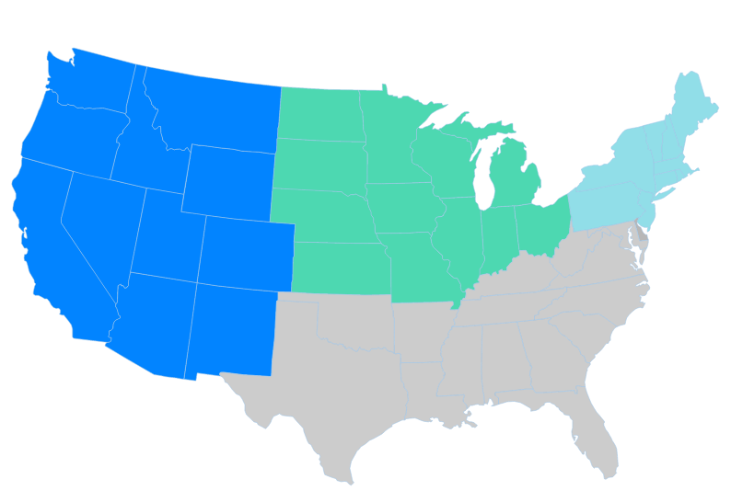
Policymakers
(n=192)
Level of Focus
National 26%
17%
West
20% Northeast
State 47%
22%
Midwest
District 18%
County 23%
41%
South
70% Urban
31% Suburban
21% Rural
City
36%
Job Description
14% | State education department
13% | Program Director
9% | Executive Director
8% | Out-of-school time intermediary
5% | Support staff
4% | Mayor’s office
40% | Other: Consultants, advocates, other govt., policy researchers, board or council members, funding orgs
Tenure
<5 years | 9%
5-9 years | 10%
10-14 years | 16%
15-19 years | 15%
20+ years | 49%
Professional role
36% Policy/Advocacy Org
32% Gov, Local
27% Gov, State
5% Gov, Federal
33% <45 yrs old
67% 45+
Notes:
Q01: Which best describes your professional role?
Q31: In what state do you work?
Q32: In what type of community?
Q33: Which of the following best describes your job?
Q34: How long have you worked in policy, education or afterschool?
Q35: At what level is your work focused now? Please mark all that apply.
Q36: What is your age?

Slide 111
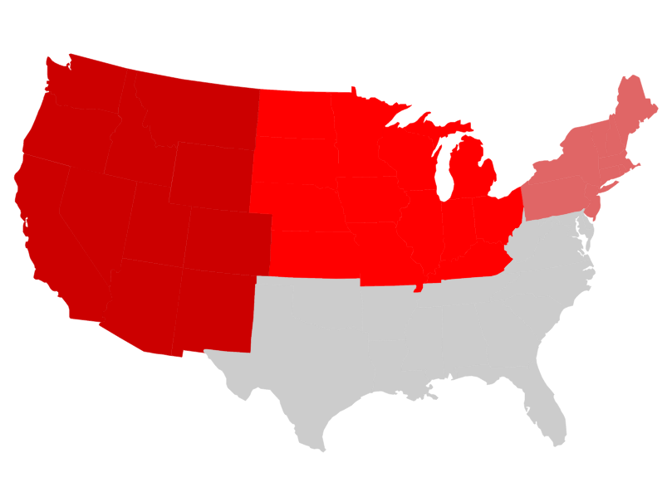
K12 Leaders
(n=331)
Level of Focus
20%
West
21% Northeast
National 4%
32% Midwest
State 12%
District 63%
36% Urban
35% Suburban
35% Rural
27%
South
County 13%
City
28%
Job Description
30% | Principal
12% | Program Director
9% | Assistant Principal
8% | District curriculum coordinator
8% | Teacher
6% | Superintendent
5% | Other school staff
5% | Executive Director
2% | Support staff
13% | Other, Includes Assistant Superintendents and school/district department leaders
Tenure
Under 5 years | 5%
5-9 years | 8%
10-14 years | 11%
15-19 years | 22%
20+ years | 54%
27% <45 yrs old
73% 45+
Notes:
Q31: In what state do you work?
Q32: In what type of community?
Q33: Which of the following best describes your job?
Q34: How long have you worked in policy, education or afterschool?
Q35: At what level is your work focused now? Please mark all that apply.
Q36: What is your age?

Slide 112
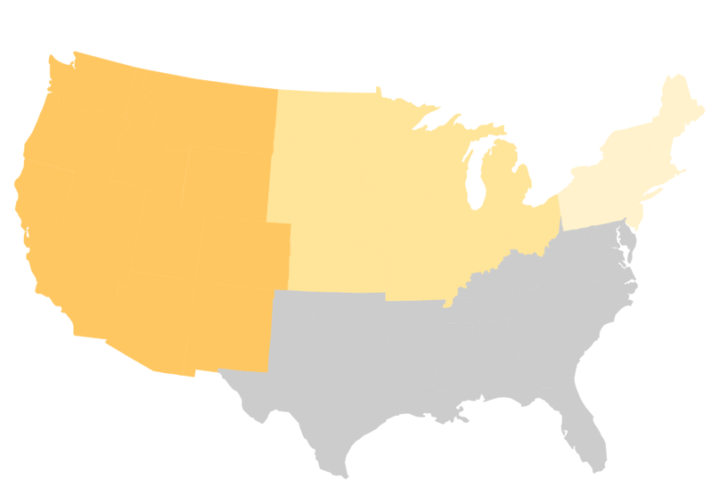
Afterschool Leaders
(n=620)
Level of Focus
National 9%
16%
West
30% Northeast
State 17%
26% Midwest
District 23%
57% Urban
36% Suburban
24% Rural
County 29%
28%
South
City
54%
Job Description
42% | Program Director
24% | Executive Director
9% | Out-of-school time intermediary
3% | Support staff
2% | Teacher
2% | Evaluator
17% | Other: Directors, coordinators, and teachers/instructors
Tenure
<5 years | 12%
5-9 years | 23%
10-14 years | 19%
15-19 years | 17%
20+ years | 29%
46% <45 yrs old
54% 45+
Notes:
Q31: In what state do you work?
Q32: In what type of community?
Q33: Which of the following best describes your job?
Q34: How long have you worked in policy, education or afterschool?
Q35: At what level is your work focused now? Please mark all that apply.
Q36: What is your age?

Slide 113
Social and Emotional Learning: Feedback and Communications Insights from the Field
Findings from parent focus groups

Slide 114
Purpose of Parent Research
Goal
Objectives
Gather feedback from parents as follow up to marketing research among professionals
To inform Wallace initiatives and communications
To support district partners communicating directly with parents
Test terms for any red-flags among parents
Understand parent mindset and education priorities
Identify opportunities and barriers related to SEL
Continue the learning on framing and messaging

Slide 115
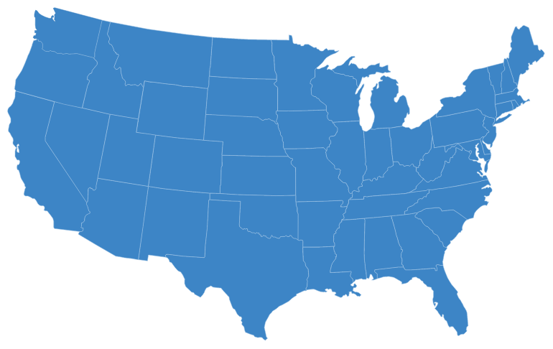
Methodology
Qualitative research in 3 markets (6 focus groups total)
Participants were parent or guardian of student/s in K-5th grade who attend public school
“Low income” defined by household income and/or child/ren eligible for free and reduced-price meal program
Racially matched moderators; Hispanic parents group conducted in Spanish
Research May 4-11, 2016
◉
Oakland
Boston
◉
Dallas
◉
Oakland, CA
6pm Low income parents, mixed race
8pm Low income parents, mixed race, skew Asian
Dallas, TX
6pm Low income parents, Hispanic, in Spanish
8pm Low income parents, mixed race
Boston, MA
6pm Low income parents, mixed race
8pm Low income parents, African American

Slide 116
Key Findings
  Parents are with this issue in spirit. They articulate SEL concepts in hopes for their children. Some use the language unprompted.
  At the same time, parents are sensitive to school and afterschool overstepping their bounds.
  The need to bring parents along as partners is a major finding from these focus groups.
Understanding Parent Mindset
  Terms preferred by professionals do well in these focus groups – SEAL & SEL.
  “Life," "skills" and "success" figured prominently when parents spoke in their own language.
  Parent feedback reinforces that it is critical to have “academics” reflected directly in messaging and context, since this is the #1 priority for schools.
  Watch the word “emotional” (can be seen as intrusive).
Choosing Language

Slide 117
Key Findings Cont.
  Parents need more warming up to the SEL topic.
  “Self management” and “emotional intelligence” are examples of technical language to avoid. On the other hand, “social skills” and “goal setting” are familiar and appealing.
  Parents want to understand practical application. They are interested in specific examples of programs and practices like those in the definition. There are some who are resistant to “evaluating” their children.
Introducing the SEL Concept
  As with professionals, the GAIN frame is persuasive. Broad themes of “success in school and life” resonate with parents and the field alike.
  The EQUITY frame continues to have a niche audience. It can alienate -- some parents found it “condescending.”
Framing

Slide 118
Parent Mindset: “K-5 Stage”
Many “positives” at this stage directly or indirectly relate to SEL.
Concerns help underscore the need for SEL.
Positives
Good student-teacher relationships
Negatives
Afterschool programs (especially in Boston)
Structure and consistency
Cultural interaction and acceptance (especially in Dallas)
Discipline
Creative and athletic opportunities
Parental involvement
Testing/standards/Common Core
Lack of communication between families and school
Lack of funding
Geographic disparity in schools (especially in Boston)
Parents needing to intervene
“Pre-K is helping him build a solid base. He’s becoming a more social creature. The school is bilingual. There are many positives.” Dallas, 6pm
“It’s all about the test. Testing at 3rd grade just feels a little too early for me.” Oakland, 6pm

Slide 119
Parent Mindset: “Everything Else”
Parents have many “hopes” for their children beyond academic success.
Some even use the language of “social” and “emotional” qualities.
That said, few parents can name a program or curriculum locally that is focused on these skills.
“Social skills are what they need now. Social skills and self confidence. It’s a big step going out into the world.” Dallas, 8pm
“I don’t want my children to be frustrated or confused and then stop learning…. I want my kids to have goals, motivation, and learning that gets them excited.”
Boston, 8pm
Parent language:
Life Learning, Keys to Life, Life Lessons, Life Skills, Life Successes, Basics for Success, Keys to Happiness, Social Skills
Moderator probe: One category of learning is “academics,” like reading, writing, math. Then there’s this category of “everything else” –skills that can help a person do well in school, at work, and in life. In your opinion, what else do your children need to learn?

Slide 120
Effective Terminology With Parents
(in no particular order)
Term | Assessment | Direct Feedback
Social-emotional & academic learning (SEAL) | Top term in most groups, viewed as all-encompassing, emphasizes the connection between emotional well-being and academic success; can happen in and out of school. | “’Academic’ makes it part of the class. I expect my son to learn social, emotional and academic learning combined.” Oakland, 6pm
Social & emotional learning (SEL) | Same as SEAL for some, but for others the lack of “academic” means this is more of the parents’ responsibility. SEAL & SEL connote and denote the topic. | “When you take ‘academic’ out, it’s less about interacting with teachers and classmates and more interacting with other individuals.” Boston, 8pm
Life skills | What many parents naturally called the “everything else.” The fundamentals that support all else. Taught at home and at school, covers everything from hygiene to respect for others. | “Like an infant needs to learn the basic life skills of the world. When they go to school, these are the basic skills of school: respect the teacher, show up, do the work, etc. It’s a foundation.” Boston, 8pm
Character | An interesting difference between the parent & professional findings. In these groups, many parents knew the term and perceived it as an essential quality to develop. | “If you have good character, the other stuff will follow. It’s the foundation created for a child. It comes from home before school, then school has a role in supporting it.” Dallas, 8pm

Slide 121
Less Effective With Parents
Term | Assessment | Direct Feedback
Youth development | An umbrella term for multiple concepts. Some parents immediately associated this with out-of-school or afterschool time. | “I’m thinking youth programs, not school, outside of school – like Boys and Girls Club, Kiwanis, YMCA – afterschool programs.” Dallas, 8pm
Success factors | Largely negative term. Parents perceived it as arbitrary, imposed benchmarks, a concept inappropriate for children this age. | “I know my son wants success but I don’t want him to focus on that. At this age it’s not the right focus. It’s very relative.” Boston, 6pm
Emotional intelligence | Unclear meaning; negative reaction to the idea that a child lacks emotional intelligence. Some viewed it as being emotionally resilient, or managing emotional reactions. | “I don’t like that phrase. It’s like, ‘Am I intelligent enough to camouflage my emotions?’” Oakland, 8pm
21st century skills | Distracted from the topic. Consensus this refers to mastering technology. Important but parents worried about over-emphasis. | “It’s like typing. It’s great to learn these skills, technology, but their faces are buried into phones – socializing is in person.” Dallas, 6pm
Soft skills | Not familiar language and parents were unsure of the meaning. No adequate Spanish translation for this term. | “I think it’s like washing hands after sneezing. It’s what you should do but not a necessity.” Boston, 6pm

Slide 122
Response to Definition
With the definition on paper, parents started to push back on the topic.
For some parents the emphasis on “emotional” and personal development went too far --
“emotional intelligence,” “self-management,” were terms that elicited mixed feedback.
Parents repeatedly questioned the need for teacher training or shifting resources in this direction.
Many objected to assessment
(it’s too vague, subjective).
The topic:
Helping students develop emotional intelligence, positive attitudes, persistence, self-management and relationship skills.
Students learn and develop these skills in many settings: at home, in school, and during afterschool activities.
Communities can support children’s social and emotional learning with programs in schools and in afterschool programs, and by training teachers and afterschool staff to develop these skills. We need to make social and emotional learning a priority.
For example:
A teacher might choose a project or curriculum focused on teamwork and empathy.
A district or school might incorporate social and emotional skills into its annual assessment of how well it’s educating students.
An afterschool program might do activities to build persistence, help children set goals, and prepare them to be successful adults.
Blue=Positive
Aqua=Questions/mixed
Red=Negative

Slide 123
Warming to the Topic
On first read, the definition felt intrusive and lacked credibility
“I don’t want people judging my child.” Boston, 6pm
“Support it. But priority means #1. I think church and my house is where it’s #1, not at school.” Dallas, 8pm
“I want schools teaching this but am not sure they can. They have so much on their plate already.” Oakland, 8pm
In discussion, focus on “all children” and familiar skills won support
“If they are not getting this at home, I hope someone will provide it. It takes a village.” Dallas, 8pm
“Children’s learning starting at home, but also learning at school and afterschool, is a better formation.” Dallas, 6pm
“As long as the standard rules apply like no hitting and respecting others… I just don’t want them to program our kids.” Oakland, 6pm
“It’s needed. It’s just not tip top over other things.” Boston, 8pm

Slide 124
Current Experience
Across the focus groups, we heard varying examples of SEL in practice.
From most…
…To least familiar
“In addition to the academics, they need social and emotional connections so that they know how to deal with people. It does get different.” Oakland, 6pm
[unaided mention of ‘social and emotional’]
“Our district is small and in the country. They really push character-driven values. I never expected it from public school.” Dallas, 8pm
“Some schools are doing this, incorporating these skills into lessons. Some don’t, but a lot of schools are starting to add it in because of bullying and violence and kids not getting to know each other with different backgrounds.” Boston, 8pm
“In my district all the extra-curriculars were cut, like camping and things that would teach social and emotional learning.”
Oakland, 8pm
“What is emotional learning? Are they going to practice crying for 5 minutes, and then practice smiling?... I didn’t learn my emotions in school.” Boston, 6pm
“I’m trying to interpret what this means. A school district and social and emotional skills? I don’t know how it could be applied in practical ways. How do you do that?” Dallas, 6pm

Slide 125

Parents on Roles:
Home:
“Where It Starts”
School:
“Reinforcement”
Afterschool:
“Expanding Horizons”
“This is something you teach at home.”
Oakland, 6pm
“Parents first, teachers second. Family values and good behavior start at home.” Dallas, 6pm
“We have the ‘Wiley Way’ at my granddaughter’s school. They have core values, social stuff.”
Dallas, 8pm
“School is where kids express themselves. They interact with others.” Boston, 8pm
“The YMCA comes to my son’s school…. It’s helping his self-esteem and getting him involved.” Boston, 6pm
“We had an afterschool program for boys, young African American boys. It helped my son.”
Oakland, 8pm
The foundation comes from home.
Parents expect to be partners in any intervention or action.
Particularly relevant: goal setting, persistence, social skills, building positive relationships, appreciating diverse backgrounds
Particularly relevant: teamwork, confidence, learning from mistakes/losses, becoming well-rounded

Slide 126
Testing Frames
Most popular “frames” from the market research among professionals were tested in these parent focus groups
Evaluated on multiple dimensions
Relevance–
To me as a parent
Believability–
Based on what I know
Convincing–
As a reason to make this a priority at my school
Gain
Empowerment
Equity

Slide 127
Testing Frames (text tested among parents)
Gain
Children will benefit.
Making social and emotional skills part of the learning equation will help children succeed in school and life. With social and emotional skills, children can manage emotion, build positive relationships and navigate social environments. When adults focus on helping children develop these skills and are supported by good policies and training, children are better prepared for the world and able to fulfill their potential.
Empowerment
We can make a real difference.
Leaders in education and youth development can have a profound effect on the next generation by prioritizing social and emotional support. When students feel loved, nurtured and safe -- those students are better equipped for learning in school, afterschool and at home. All adults have a role to play in developing the social and emotional skills children need for success in school and life.
Equity
This helps address the problem of inequity.
Children from high-poverty, at-risk neighborhoods have less access to the kinds of enriching experiences that build social and emotional skills crucial for success in school and life. That’s an opportunity gap that we must close in the system, by ensuring that schools and afterschool programs are equipped to help children develop social and emotional skills as well as academic skills.

Slide 128
Feedback: Gain Frame
What works:
Effectively sums up the topic. The message feels relevant and factual.
Ties to future success in a way parents can believe.
“Part of the learning equation” makes it important but not the only priority.
Less effective:
“Focus” can be a turnoff for those who fear this will take away from academics.
“All of that is what you want for your kids in the end, for them to be happy, healthy, sociable beings.” Boston, 8pm
“When we were kids they only focused on academics, but if you bring all these aspects you can have full success.”
Dallas, 6pm
“I’ve seen too many kids fall through the cracks. I wish I had learned some of these life skills as well as academics when I went to school.” Oakland, 8pm
“This should be in the package, not a focus.” Dallas, 8pm

Slide 129
Feedback: Empowerment Frame
What works:
Parents like the emphasis on “all adults.”
For some, the link between feeling safe and being able to learn rings true.
Less effective:
“Education leaders” and “administrators” are not parents’ preferred messengers.
Some don’t believe that feeling “loved and nurtured” is intrinsically necessary for success.
“When students feel loved, nurtured, safe – this is more important than getting 100% or all A’s.” Dallas, 6pm
“I like this message, although I’m not sure school and afterschool is where this happens, that’s our job as parents.” Oakland, 6pm
“All adults have role, every adult that comes into contact with a child, but I think more about teachers who are day-to-day on the ground with the child.” Boston, 8pm
“I disagree. You can give a child a lot of love and they still feel like you don’t care. Children without a great home life want more and strive, so it’s not about love.” Boston, 6pm

Slide 130
Feedback: Equity Frame
What works:
Some recognize inequity and believe SEL has a role in “filling the gap.”
Those with first-hand experience of disparity seem most receptive.
Less effective:
Parents across groups found the idea and language condescending.
Calling out the negative put some of these low income parents on the defensive.
“I feel support is missing. I live in a dangerous neighborhood, but many people don’t care about African Americans.” Boston, 6pm
“I grew up in poverty and didn’t have resources. Every district should have the same access.” Oakland, 8pm
“This is very offensive to me. A lot of children are from poverty, they struggle, and they turn out to be highly successful. They want to do even more and get out of that life.” Oakland, 6pm
“This is silly. You can be the poorest person in the world and have self confidence.” Dallas, 6pm

Slide 131
Language – What Works/What Doesn’t
Focus groups suggest ways to tune the SEL message for parents.
Dos
Don’ts
Stress the complement to academics:
“the learning equation”
“beyond academics”
“in addition to”
“for school, for life”
Frame the big picture:
“helping students”
“succeed”
“all students” benefit
“fulfill potential”
“life lessons”
Acknowledge all roles:
adults, home, school, afterschool
Start with familiar skills to build up the case
Leave parents out
(directly or indirectly)
Stress “emotional” over social and academic
Try to create “a priority” over academics
Fast-forward too quickly
to individual assessment or school evaluation
Lead with inequity
(or suggest family insufficiencies)
Overlook the how-to and practical application

Slide 132
Contacts
Pam Loeb, Stacia Tipton,
Erin Wagner
Edge Research
loeb@edgeresearch.com
tipton@edgeresearch.com
wagner@edgeresearch.com
703-842-0200
Lucas Held, Hilary Rhodes,
Melissa Connerton
The Wallace Foundation
LHeld@wallacefoundation.org
HRhodes@wallacefoundation.org
MConnerton@wallacefoundation.org
212-251-9700

