Slide 1

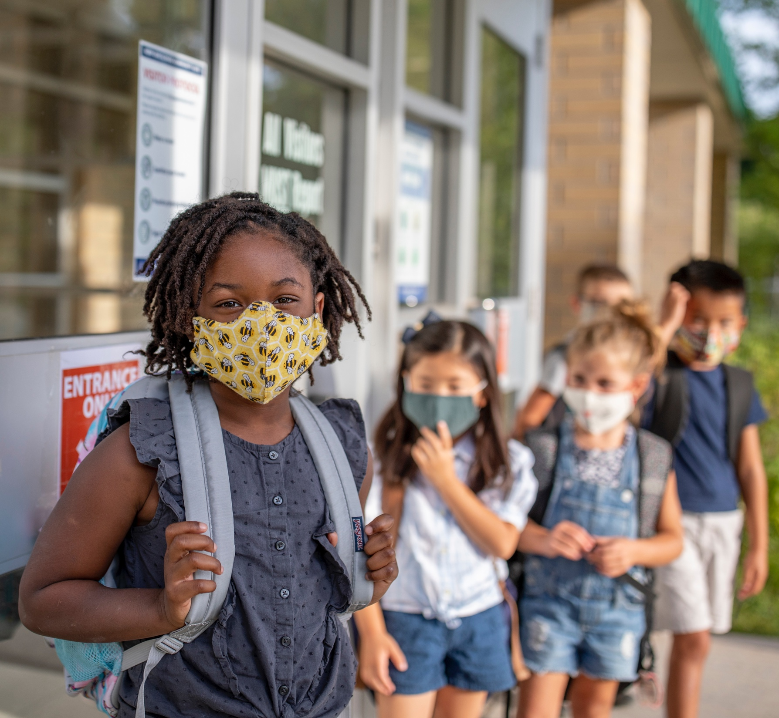


Supporting Quality in Summer Learning:
Study Findings
How Districts Plan, Develop, and Implement Programs
June 14, 2022
Notes:
Tony

Slide 2
Housekeeping Notes
This webinar will be recorded
The recording and slides will be posted by the end of the week at wallacefoundation.org or edc.org
The chat function has been disabled for this webinar
To ask a question, use the Q & A function
For technical help, please e-mail events@thehatchergroup.com
Notes:
Tony

Slide 3
Agenda
Welcome
Study Overview
Key Findings
Conclusions
Q&A
Adjourn
Notes:
Tony

Slide 4
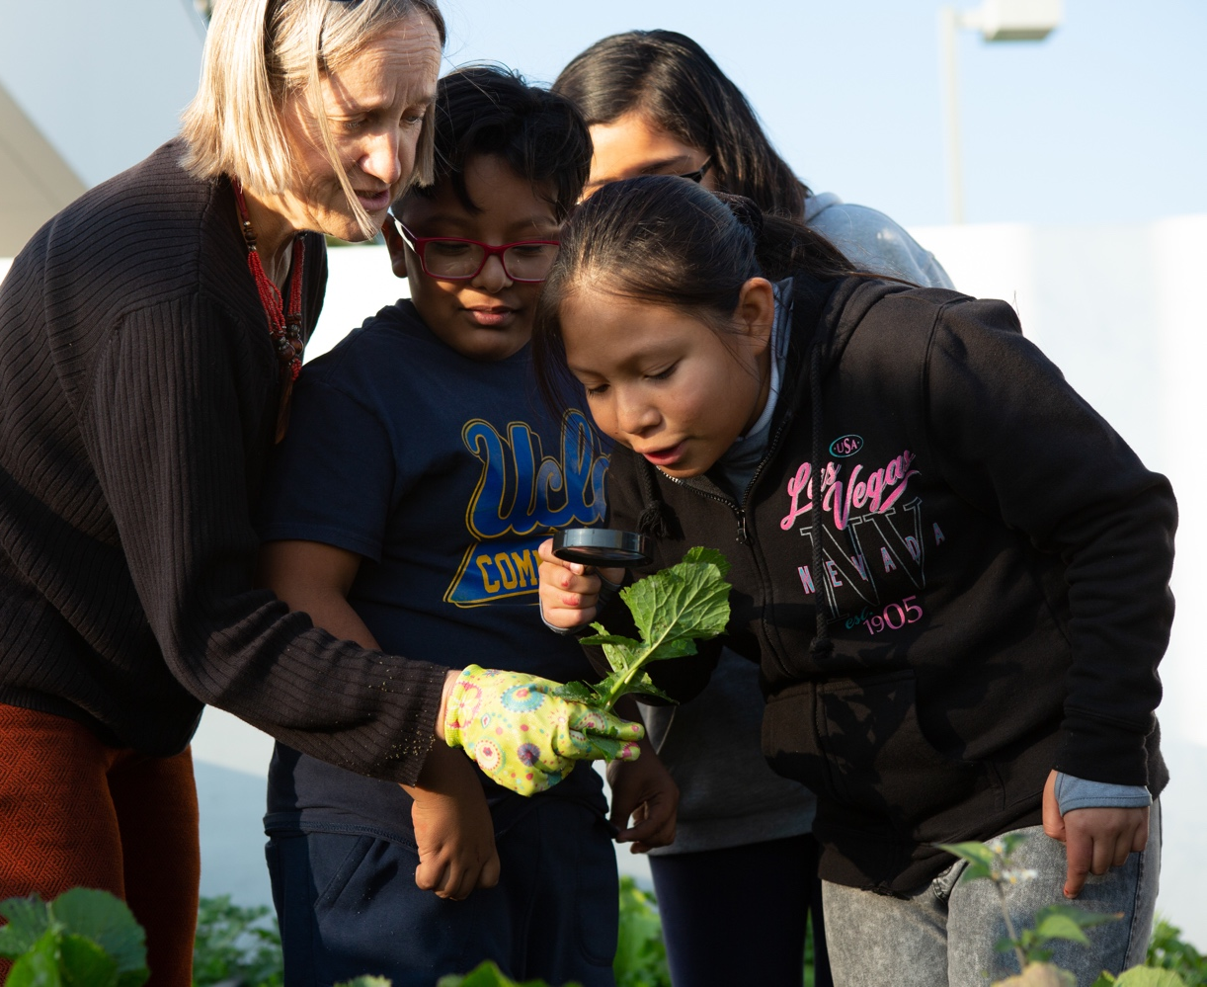

Context of
Study
Notes:
Ann

Slide 5





Our Panelists
Leslie Goodyear
Principal Evaluation Director
Tony Streit
Managing Project Director
Alyssa Na’im
Research Scientist
Sheri Endsley
District Superintendent
Fort Worth Park & Recreation Department
Lisa Johnson Associated Director of Extended Learning Programs Green Bay Area Public School District
EDC Research Team
Respondents
Notes:
Tony

Slide 6

About the Study
21st CCLC
Focused on overarching lessons across three summers
Purpose: Examine how district-led, publicly funded summer learning programs that serve K-8 aged youth in urban settings access and use professional learning and tools to improve and advance equitable outcomes for the students they serve.
Districts
State
Supports
Federal
Funding
Examining broader systems of support
Public funding
State systems of support
21st CCLC
Research questions focused on
District policies and practices
External supports like PD, resources, and tools
District needs, gaps, and opportunities
Families and communities
Notes:
Leslie

Slide 7
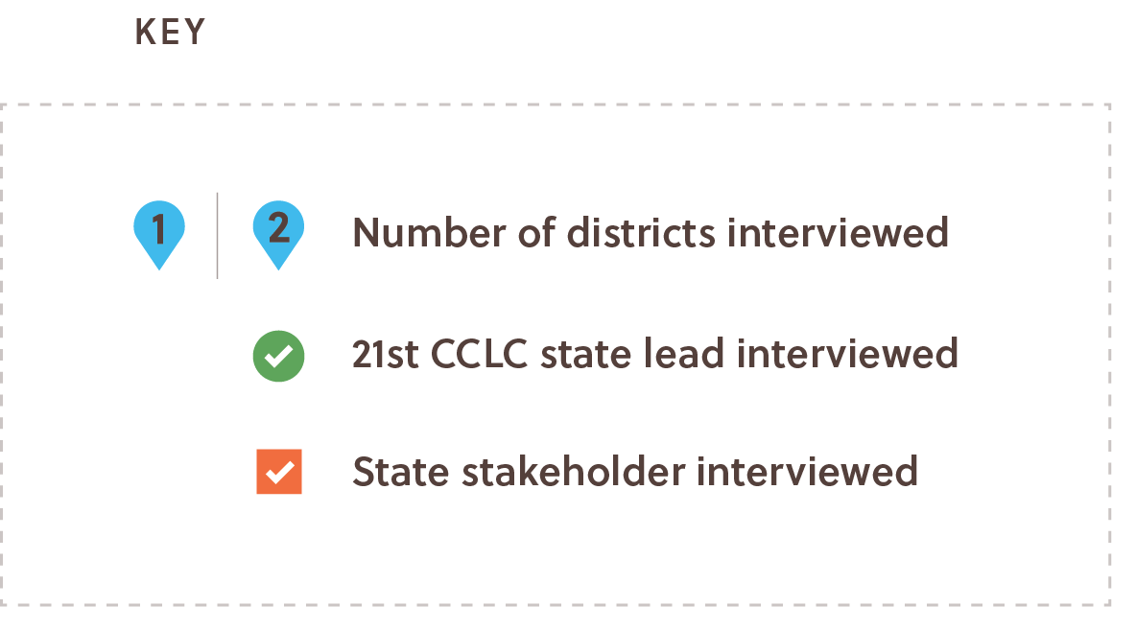
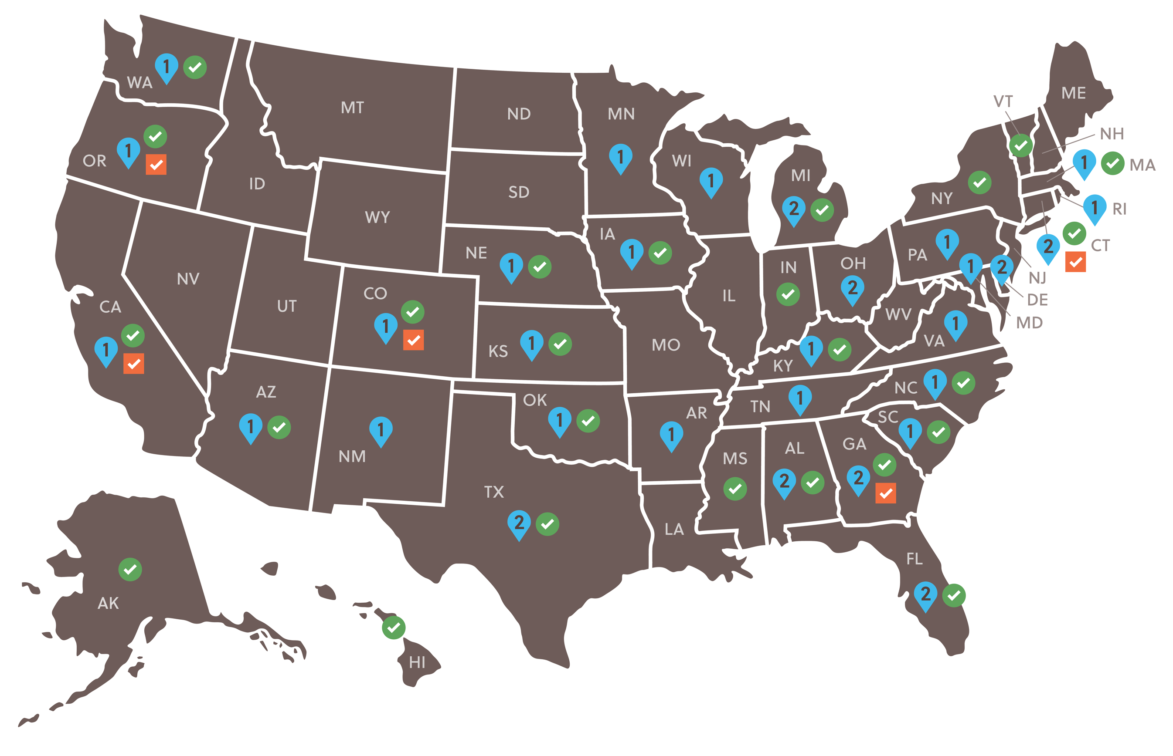
Approach
Methods
Foundational research: Online research and document review informed sample design and questions to explore.
Primary research: Collected data from district representatives, partner organizations, 21st CCLC state leads, other state representatives.
Consulted with study advisors and Wallace to develop the design and sample and identify issues to explore.
Faced limitations in accessing appropriate staff and stakeholders.
92 respondents from 36 states
47 representatives from 38 districts in 30 states
34 staff from 25 21st CCLC state offices
11 state stakeholders in 5 states
Notes:
Leslie

Slide 8
Data Collection
Adjusted to data collection due to COVID-19 but maintained focus on overarching lessons.
Interviews with 21st CCLC state leads
Follow-up survey
Interviews with district leaders
Interviews with state stakeholders
Oct
Nov
Dec
Jan
Feb
Mar
Apr
May
2020
2021
Decisions about return
to in-person instruction
Districts constantly dealing with remote or hybrid instruction
CRRSAA Passed
ARPA Passed
Notes:
Leslie

Slide 9

Key Findings
Notes:
Tony -> Alyssa

Slide 10
FINDING #1
Districts prioritize academics but recognize the importance of engaging, accessible programs
Programs are commonly tied to local or state policies like elementary reading and literacy initiatives.
Other aims include SEL, safe environment, fun activities, links to community resources, enrichment opportunities.
Additional supports include transportation, food, afternoon care, free or affordably priced.
Notes:
Alyssa

Slide 11
FINDING #2
Partnerships and collaborative decision-making was a consistent theme for summer programs
District leadership set vision and policy, ensure quality, and make connections to families and communities.
Community partners can play an essential role in supporting district-led programs:
  Roughly 95% of districts reported partnerships
  Partners bolstered expertise in SEL, outreach, recruitment, and enrichment
  Some districts struggled to develop mutually beneficial arrangements
Notes:
Leslie

Slide 12
FINDING #3
Educators and staff have access to a variety of PD, yet there remain unmet needs in key areas
Districts seek to be responsive to the needs of their communities and consult with program staff and teachers when prioritizing specific topics for PD.
Common topics include literacy, supports for ELLs, supports for students with special needs, and racial justice and equity.
Areas of greatest need include student and staff mental health and well-being, trauma-informed practices, SEL, and DEI (diversity, equity, and inclusion).
Notes:
Alyssa

Slide 13

Conclusions
Notes:
Leslie

Slide 14
Conclusions
Future supports can build upon evidence-based practices with a focus on whole-child learning.
Effective partnerships are critical to the success of summer learning programs.
Pandemic-related funding offers opportunity for strategic investments, especially related to quality improvement and sustainability strategies.
A more in-depth examination of district summer learning programs and related supports would yield valuable information to help inform the field.
Notes:
Leslie

Slide 15

Q&A
Notes:
Tony

Slide 16
Thank You!
Leslie Goodyear
lgoodyear@edc.org
Alyssa Na’im
anaim@edc.org
Tony Streit
tstreit@edc.org
Notes:
Tony

