Slide 1
Social and Emotional Learning: Feedback and Communications Insights from the Field
Findings from market research conducted for The Wallace Foundation
By Edge Research
Summary Presentation
December 2016

Slide 2
Goals for Research
Primary
Understand the landscape of terminology from the perspective of key stakeholders
Understand what motivates K-12 public school, Afterschool and Policy leaders to be interested in the topic
Help the field develop a common vocabulary on the topic
Secondary
Understand where social and emotional learning fits in context with other competing priorities
Understand how key audiences think about social and emotional learning connecting to their work
Produce findings that support the communications efforts of Wallace, partners and the community

Slide 3
Market Research Approach
Phase I: Desktop Research (Summer 2015)
Edge synthesized background materials provided by Wallace, web searches, text analytics and trends data. This led to an inventory of terms and initial hypotheses. Findings informed a working session with Wallace and a short list of terms for further study.
Phase II: Qualitative Research Among Professionals (Fall 2015)
Edge completed 45 in-depth interviews among K-12, Afterschool and Policy leaders. Discussions explored perceptions of terms and the topic in more detail. Findings informed a messaging session with Wallace, where the team started to draft content for the survey phase.
Phase III: Quantitative Research Among Professionals (Winter 2016)
Online survey of n=1,600 Professionals (192 Policymakers; 331 K-12 Leaders; 620 Afterschool Leaders). Wallace designated 5 terms of interest, and Edge designed a survey to test the strengths and weaknesses of those terms. The survey also explored potential message frames.
Follow Up: Focus Groups with Parents (Spring 2016)
As follow up to marketing research among professional audiences, Wallace asked Edge to gather parent feedback. Conversations with low income parents helped the team understand SEL mindset, gut-check terminology, and continue the learning on framing and messaging.

Slide 4
Key Findings
1
There is no “silver bullet” term, but across the research phases, “social and emotional learning” emerges as one that is familiar and clear for Policy, K-12 and Afterschool leaders. It also tests well in parent focus groups.
2
Over the course of research, we moved away from terms that had strong, ancillary or even negative connotations (21st Century Skills, Whole Child Development, Soft Skills, Character). We also eliminated familiar terms deemed too generic for this topic (Youth Development, Success Factors).
3
In framing this issue, a concept that speaks to “Gains” for children has traction. Specifics about SEL skills (i.e. building positive relationships, navigating social environments), plus positively asserting that all children benefit, make this frame popular across stakeholder and parent audiences.
4
Other frames include language that resonates. Consider the right time to weave in themes and ideas about: all adults having a role, the learning equation, children realizing their potential, future citizens and the opportunity gap.
5
Despite agreement that SEL should be a priority, challenges exist for the future. The field identifies training and professional development as much-needed. Parents are wary of school and afterschool overstepping their bounds.

Slide 5
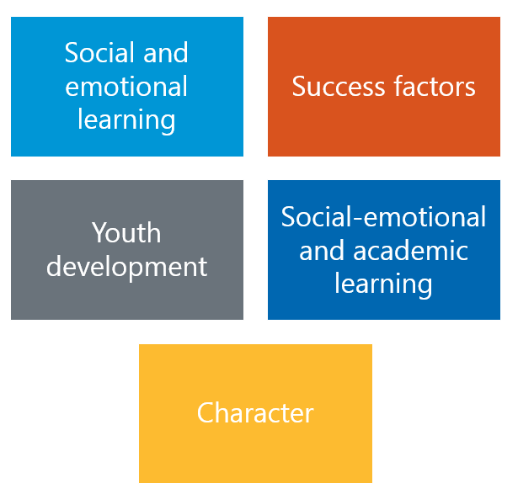
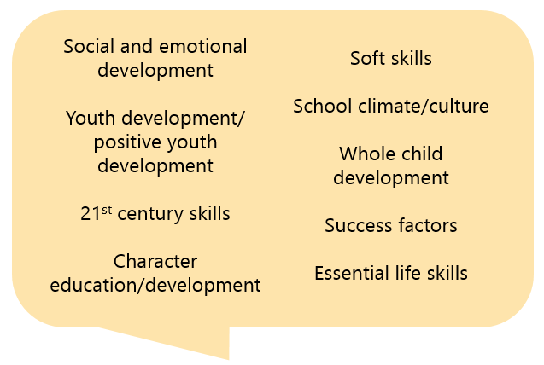
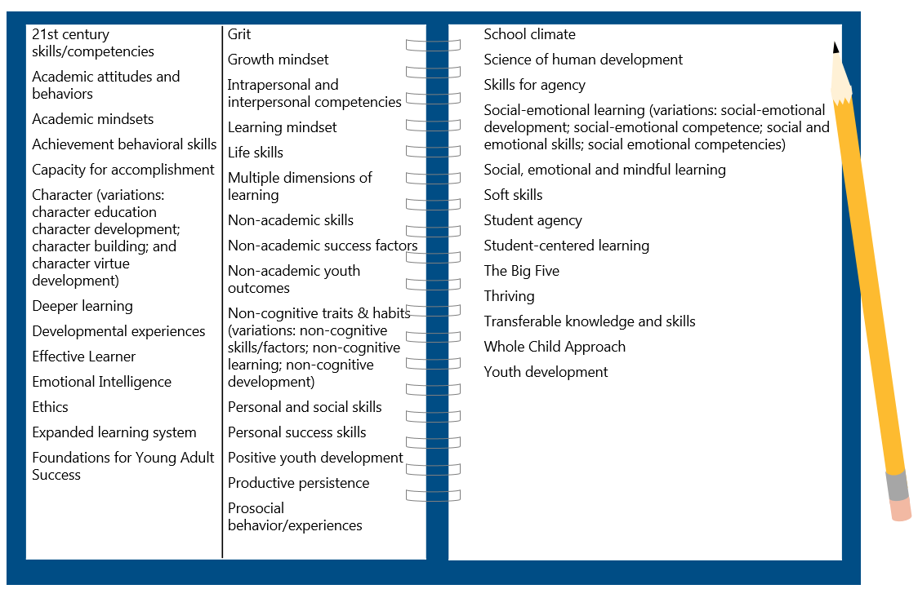
Learning Path
2 Finalist Terms: SEL and SEAL
Parent focus groups revisited the landscape of terms and vetted these two terms
5 Terms of Interest in Quantitative
9 Terms Explored in Interviews
All with merit; all received the same treatment in the survey
Identified by working session; led to terms for survey testing
40+ Terms Circulating
Assessed in desktop research

Slide 6
Desktop Research: 40+ Terms Circulating
Desktop research identified 40+ terms for this topic, with countless variations.
21st century skills/competencies Academic attitudes and behaviors Academic mindsets Achievement behavioral skills Capacity for accomplishment Character (variations: character education character development; character building; and character virtue development) Deeper learning Developmental experiences Effective Learner Emotional Intelligence Ethics Expanded learning system Foundations for Young Adult Success | Grit Growth mindset Intrapersonal and interpersonal competencies Learning mindset Life skills Multiple dimensions of learning Non-academic skills Non-academic success factors Non-academic youth outcomes Non-cognitive traits & habits (variations: non-cognitive skills/factors; non-cognitive learning; non-cognitive development) Personal and social skills Personal success skills Positive youth development Productive persistence Prosocial behavior/experiences
School climate Science of human development Skills for agency Social-emotional learning (variations: social-emotional development; social-emotional competence; social and emotional skills; social emotional competencies) Social, emotional and mindful learning Soft skills Student agency Student-centered learning The Big Five Thriving Transferable knowledge and skills Whole Child Approach Youth development

Slide 7
Desktop Research: Term Inventory
Analyzing terms on four dimensions helped Wallace prioritize terms of interest.
C
 | Frequency (how often used) | Clarity (of meaning) | Acceptance (by stakeholders) | Sources (who is using it)
21st Century Skills | High | Mixed | High | Many
Soft Skills | High | Mixed | High | Many
Social and Emotional | High | Mixed | To be determined | Many
Grit | Medium | Mixed | Medium | Some
Growth Mindset | Medium | Mixed | Medium | Few
Whole Child Development | Medium | Mixed | Medium | Few
Character Development | Medium | Negative | Low | Few
Non-Cognitive | Mixed | Negative | Low | Limited
Positive Youth Development | Low | Positive | Medium | Few
Academic Attitudes | Low | Negative | Medium | Few
Behavioral Skills | Low | Negative | Low | Few
Key: Higher, Middle, Lower

Slide 8
Qualitative: Findings on Terms
Over the course of 45 stakeholder interviews, we learned that these terms had more potential to be effective than others. At the same time, all had pitfalls.
Social and Emotional Learning
Conveys the right subject matter and is used often in K-12 and Afterschool. Some feel the phrase lacks urgency.
Whole Child Development
Provides an opening to talk about SEL, but much broader. Of the four finalist terms, this is probably the most ideological and divisive.
Success Factors
Sets the right tone for shared goals, qualities to nurture in a student.
However, it’s generic and not an obvious bridge to talking about SEL.
Youth Development
The epitome of a “widely accepted” term and often preferred. But it might be hard to energize target audiences around an idea so familiar and broad.

Slide 9
Social and Emotional Learning
✓
DESCRIPTIVE
ACCEPTANCE
URGENCY
Covers a wide range of skills including self-management, conflict resolution, teamwork
Broadest interpretations include mental health supports and services
Some sources point out the important difference between social learning and emotional learning
Some difference in interpretations of social and emotional “learning” and “development”
Leading term in use today; default term for many
Acceptable to all three stakeholder audiences
At the same time, sources say the phrase is too much like jargon
Politically neutral, but talking about “emotions” gives some a liberal feel
“Learning” can be uniting (active, intentional)
Buzzword “of the moment” for Afterschool and some K-12 leaders
An open question is whether it will resonate with a wider audience (e.g. policy, parents)
Can feel “too touchy feely” to be a priority for policy
Overall, lacks urgency
BOTTOM LINE
Conveys the right subject matter and is used often in K-12 and Afterschool. But the phrase can be seen as “jargon” and lacks some urgency.

Slide 10
Whole Child Development
✓
DESCRIPTIVE
ACCEPTANCE
URGENCY
Accounts for all aspects of a child’s growth: academic, physical, social and emotional
“Holistic” approach to learning
May or may not include basic needs: food, shelter
Sources say this concept is much bigger than SEL (social and emotional learning would be a component under it)
The conventional meaning helps tie SEL to academics
“Child” implies young students (K-8)
Many in interviews say it is a “progressive” concept, linked to “liberal” ideology
Some respondents raise a red-flag saying critics will argue this is beyond the role of schools
More than one source criticizes this term as jargon
“Old” term but robust
Many favorable toward it
Preconceived notions (people attach their own meanings – positive and negative)
Overuse is a concern (a reason to tune out)
Expansiveness is a concern (taking us away from the practice of SEL)
BOTTOM LINE
Provides an opening to talk about SEL, but much broader. Of the four finalist terms, this is probably the most ideological and divisive.

Slide 11
Success Factors
✓
DESCRIPTIVE
ACCEPTANCE
URGENCY
Puts the focus on outcomes and benefits (more than approach or practice)
Implies long-term: college and career readiness more so than other terms
Competing definitions of “success” make it vague
Calls attention to “deficits” often environmental: What does success mean? Can students defy the trend and expectations?
Success means different things to different people; K-12 see it as test scores, Afterschool tend to see it more in the realm of SEL
A new term – has currency, but is still being defined
Heard more in K-12 than Afterschool or Policymaker interviews
Sources are enthusiastic about this term - everyone cares about success
“Starting to catch on” since Department of Ed started using this language
Gets leaders thinking about what makes people successful
While they perk up at the language, it is also generic, and it takes a transition message to get to SEL
BOTTOM LINE
Sets the right tone for shared goals, qualities to nurture in a student.
However, it’s generic and not an obvious bridge to talking about SEL.

Slide 12
Youth Development
✓
DESCRIPTIVE
ACCEPTANCE
URGENCY
Is a crowd-pleasing term with a wide variety of definitions
According to sources, it includes SEL, providing opportunities to students
“More than reading and math” is a common way to explain it
Most closely affiliated with Afterschool; but K-12 and Policymakers embrace the term in these interviews
A pitfall is that it seems to imply older “youth” (tweens and teens)
Politically neutral and versatile: can evoke responsibility (appealing to conservatives) or independent thinking (appealing to liberals)
Familiar language, but no real urgency, it might be difficult to rally support
Risk in being too familiar, something these audiences already know and do
That some communities are adopting this term now might suggest new interest
It is consistently appealing, often preferred in these interviews
BOTTOM LINE
The epitome of a “widely accepted” term and often preferred. But it might be hard to energize target audiences around an idea so familiar and broad.

Slide 13
Qualitative: Less Effective Terms
✓
Term | Descriptive | Acceptance | Urgency | Bottom line
21st century skills | Used loosely and with multiple meanings. | Heard or used by all audiences and business leaders. Rejected by many who see it as dated and/or gimmicky. | Relevant to today’s world. What kids need now (or needed 10 years ago). | A lot of unrelated connotations (tech, workforce, funding). At worst “old hat.”
Character | Morals, ethics, positive social interaction, compliance, respect, responsibility, civic duty. | Everyone understands it. More appealing to conservatives. | Unclear if this is education’s job—overstepping family role? Dated for some. | Ideological red flags: “moral” implications, “religion,” “elitism.”
Soft skills | Emotional intelligence, communication and relationships - things that can’t be graded. | Used by some educators, afterschool and business community. | “Soft” diminishes importance and urgency. | Too many strikes against this term. Many sources say they won’t use it.
School climate/ culture | Conditions in which school and SEL happen, safety, discipline. | Alienates afterschool. | A related and important concept - necessary for SEL to occur and a result of SEL. | Too broad to be the lead term. Exclusive to schools.
Essential life skills | Basic skills for daily living (i.e. budgeting), prep for work and life. | Not widely used; not preferred over other terms. | Necessary to succeed in life, but possibly not education’s responsibility. | Implies a value judgement that’s a turn off, us v. them.

Slide 14
Survey Testing
General impressions – positive/negative (5 pt. scale)
After Wallace definition – most descriptive; most natural language; most motivating (pick 1)
Connotations – partisan leanings; term of past vs. term of future; system approach vs. individual program (slide rule ratings)
On reflection – term you prefer (pick 1); terms to avoid (multi-select)
Online Survey of 1,600
Policymakers (192)
K-12 Leaders (331)
Afterschool Leaders (620)
Other Stakeholders (457)
Fielded Feb. 23 – March 24, 2016

Slide 15
Topic Defined
The survey offered a working definition from The Wallace Foundation.
Working definition of the topic:
Supporting students to develop emotional intelligence, positive attitudes, persistence, self-management and relationship skills.
These skills can be developed in any setting, at any point in the school day or after school.
Their development can be supported through programs, practices, procedures and policies.
Examples from the field:
Incorporating social and emotional skills into policies for school assessment.
Preparing students to be successful adults.
Programming or curriculum focused on teamwork, persistence and empathy.

Slide 16
Quantitative: Findings on Terms
The survey confirms there is no “silver bullet” term for this topic.
But across the research phases, “social and emotional learning” emerges as one that is familiar and clear for all 3 professional audiences.
Character
Of the terms tested, this got the weakest scores on most dimensions, and the largest number say to “avoid it.”
Success factors
Falls short as an overarching term. But neutrality and urgency of the language suggest could be useful in messaging.
Youth development
This term means something to Afterschool, and Policymakers find it appealing, but it’s unlikely to catch on in K-12, and thus not a strong contender.
Social-emotional and academic learning
A close rival to SEL. Quantitative testing shows this term has similar qualities, plus the advantage of resonating with K-12.
Social and emotional learning
Familiar language that achieves the objective to communicate clearly. Pitfalls are it lacks urgency and is seen as more liberal, though fewest number say to “avoid it.”

Slide 17
SEL vs. SEAL
Social and Emotional Learning vs. Social-Emotional and Academic Learning
Positive Feelings
(top 2 box)
Most Descriptive
(pick 1)
Most Urgent
(pick 1)
Preference
(pick 1)
Term Viewed as
Liberal, Neutral, Conservative
Policy | K12 | Afterschool
77% | 82% | 88%
Policy | K12 | Afterschool
70% | 81% | 82%
Policy | K12 | Afterschool
33% | 32% | 35%
Policy | K12 | Afterschool
27% | 40% | 27%
Policy | K12 | Afterschool
17% | 16% | 21%
Policy | K12 | Afterschool
24% | 36% | 22%
Policy | K12 | Afterschool
24% | 24% | 33%
Policy | K12 | Afterschool
28% | 39% | 24%
Policy | K12 | Afterschool
53%, 39%, 8% | 54%, 37%, 9% | 56%, 39%, 5%
Policy | K12 | Afterschool
43%, 42%, 15% | 49%, 39%,12% | 40%, 44%, 16%
## bold=statistically significant head 2 head
* = top choice in category
Notes:
Q03: What is your immediate reaction to each of the following terms?
Q04: Based on The Wallace Foundation's definition of the topic, which term is most descriptive? Please choose the term that in your opinion best matches the definition.
Q06: Which term has the most urgency for you and your organization to devote time, attention and other resources? Please choose the term that you find the most motivating.
Q27: Now that you have spent some time going through the survey and thinking about this topic, which term do you prefer? Please select your #1 preferred term:
Q07: Think about your impression of the term XXXX. For each pair of words, select the point on the scale that indicates the degree to which you believe it describes the term, versus the other word. Conservative – Liberal

Slide 18
Parents: Feedback on Terms
Terms preferred by professionals do well in these focus groups – SEAL & SEL.
“Life," "skills" and "success" figure prominently when parents speak in their own language.
Parent feedback reinforces that it is critical to have “academics” reflected and offer a cautionary note on the word “emotional.”
Term | Assessment | Direct Feedback
Social-emotional & academic learning (SEAL) | Top term in most groups, viewed as all-encompassing, emphasizes the connection between emotional well-being and academic success; can happen in and out of school. | “’Academic’ makes it part of the class. I expect my son to learn social, emotional and academic learning combined.” Oakland
Social & emotional learning (SEL) | Same as SEAL for some, but for others the lack of “academic” means this is more of the parents’ responsibility. SEAL & SEL connote and denote the topic. | “Children need this guidance. In order to get the academic learning they need to have the social and emotional.” Boston
Life skills | Professionals did not favor this term, but it was natural language for parents. Taught at home and at school, covers everything from hygiene to respect for others. | “Like an infant needs to learn the basic life skills of the world. When they go to school, these are the basic skills of school: respect the teacher, show up, do the work, etc. It’s a foundation.” Boston
Character | An interesting difference between the parent & professional findings. In these groups, many parents knew the term and perceive it as an essential quality to develop. | “If you have good character, the other stuff will follow. It’s the foundation created for a child. It comes from home before school, then school has a role in supporting it.” Dallas

Slide 19
Frames Tested
Children will benefit.
Making social and emotional skills part of the learning equation will help children succeed in school and life. With social and emotional skills, children can manage emotion, build positive relationships and navigate social environments. When adults focus on helping children develop these skills and are supported by good policies and training, children are better prepared for the world and able to fulfill their potential.
GAIN
We can make a real difference.
Leaders in education and youth development can have a profound effect on the next generation by prioritizing social and emotional support. When students feel loved, nurtured and safe -- those students are willing to take risks for learning in school, afterschool and at home. All adults have a role to play in developing the social and emotional skills children need for success in school and life.
EMPOWERMENT
This will help us achieve a larger goal.
By prioritizing the development of social and emotional skills, we can improve future prospects for our children, develop good citizens and support the country’s workforce. Equipping children with crucial social and emotional skills can also play an important role in closing the stubborn achievement gap. For too long social and emotional skills have been pushed out of daily learning experiences for many children. Fostering these skills is a job for everybody, especially those leading our public schools and afterschool programs.
SOLUTIONS
This helps address the problem of inequity.
Children from high-poverty, at-risk neighborhoods have less access to the kinds of enriching experiences that build social and emotional skills crucial for success in school and life. That’s an opportunity gap that we must close in the system, by ensuring that schools and afterschool programs are equipped to help children develop social and emotional skills as well as academic skills.
EQUITY
PREVENTION
Not doing this will cost us later.
Unless schools and afterschool programs prioritize social and emotional learning, disadvantaged children will continue to lag behind their wealthier peers in both academic achievement and life success. If we do prioritize both social and emotional learning along with academics, we can help level the playing field.
d

Slide 20
Quantitative: Frame Preference
d
When forced to choose the most convincing frame, the Gain Frame came out on top with Policy, K-12 and Afterschool leaders.
Notes:
Q23: Of all the arguments, which is the most convincing reason for your system or organization to devote time, attention and resources to this topic?

Slide 21
Parent Feedback: Topic and Frames
Introducing SEL
Framing
We learned that parents need more warming up to the SEL topic.
“Self management” and “emotional intelligence” are examples of technical language to avoid. On the other hand, “social skills” and “goal setting” are familiar and appealing.
Parents want to understand practical application. They are interested in program examples and resist new efforts to “evaluate” their children.
As with professionals, the GAIN frame is persuasive. Broad themes of “success in school and life” resonate with parents and the field alike.
A winning element of the EMPOWERMENT frame is the emphasis that “all adults” have a role. “Parents” say they deserve a call out.
The EQUITY frame continues to have a niche audience. It can alienate -- some parents found it “condescending.”
“Children’s learning starts at home, but also learning at school and afterschool, is a better formation.” Dallas
“All of that [GAIN frame] is what you want for your kids in the end, for them to be happy, healthy, sociable beings.” Boston

Slide 22
Lessons for Framing
What motivates audiences to be involved or supportive of SEL efforts? |  | Gain frame and benefits to children. Professionals and Parents respond positively to children being “prepared” and ready to meet their “potential.”
How do we talk about this when there is no generally accepted vocabulary? |  | Specifics and program examples: “manage emotion, build positive relationships, navigate social environments;” and always in tandem with academic learning.
What are ways to customize the message by audience? |  | *All adults have a role (K-12, Afterschool, Parents) *Learning equation (for all) *Good citizens (for Policy) *Closing the opportunity gap (for some)
How far can we go in communicating the problem or potential benefit? |  | Be careful. Across audiences, push back on “prevention” and “solutions” frames gives reason to temper communication.
What are we really asking for? |  | For leaders to make SEL a “priority.” For parents to support SEL for “all children.” These messages build awareness and urgency.

Slide 23
More on Communicating with Parents
Focus groups suggest ways to tune the SEL message for parents.
Dos
Don’ts
Stress the complement to academics: “the learning equation” “beyond academics” “in addition to” “for school, for life”
Frame the big picture: “helping students” “succeed” “all students” benefit “fulfill potential” “life lessons”
Acknowledge all roles: adults, home, school, afterschool
Start with familiar skills to build up the case
Leave parents out (directly or indirectly)
Stress “emotional” over social and academic
Try to create “a priority” over academics
Fast-forward too quickly to individual assessment or school evaluation
Lead with inequity (or suggest family insufficiencies)
Overlook the how-to and practical application

Slide 24
Encouraging News
On the Agenda
SEL is a shared priority among these audiences.
Other items on the education agenda are a chance to tune and target the message (but they are not necessarily competing with SEL).
According to respondents, their communities are active and likely to stay engaged on this topic.
Policy
SEL
Training/PD
College & career readiness
Gaps in academic achievement
Program & instructional quality
Leadership development
K-12
SEL
Academic achievement
Gaps in academic achievement
Budget & resources
Program & instructional quality
Student engagement
Afterschool
SEL
Program & instructional quality
Gaps in academic achievement
Family engagement
Training/PD
Summer learning
(Top 6 priorities rank ordered, respondents could select up to 3 priorities out of 16)
Notes:
Q14: Where would you say this topic ranks right now among your organization’s priorities?
Q02: What issues are at the top of your education agenda right now? Please select up to 3 top priorities (out of 16).

Slide 25
Work to Do
4 in 5 say adults will need a lot more training and professional development to address this topic
Audiences appear primed, but not mature, in their system support of SEL.
The biggest barrier is that adults will need a lot more training to address SEL.
Audiences also say the topic is more complex than many people imagine.
Half say their system has efforts “in process” on this topic
Policy (81%)
K-12 (77%)
Afterschool (78%)
Policy (56%)
K-12 (55%)
Afterschool (55%)
Notes:
Q15: Below are some statements about the topic. How much do you agree or disagree with each?
Q25: Some people are concerned about how efforts around this topic will actually work. How much do you agree or disagree with the following statements about this topic?

Slide 26
Contacts
Pam Loeb, Stacia Tipton,
Erin Wagner
Edge Research
loeb@edgeresearch.com
tipton@edgeresearch.com
wagner@edgeresearch.com
703-842-0200
Lucas Held, Hilary Rhodes,
Melissa Connerton
The Wallace Foundation
LHeld@wallacefoundation.org
HRhodes@wallacefoundation.org
MConnerton@wallacefoundation.org
212-251-9700

